Slide 1


Quora Web Solution
Website Design and
Development
Company
Web Design & Web Development
Company in Bangalore, India
www.quorawebsolution.com
+91 9986 056 909
info@quorawebsolutions.com
24A, 1st Main Rd, Chandra Reddy
Layout, Koramangala 4th Block,
Koramangala, Bengaluru,
Karnataka 560034

Slide 2

The Role of AI in Web Development: How Artificial Intelligence Is Revolutionizing Website Design
Introduction
Artificial Intelligence (AI) has emerged as a game-changer in various industries, and web development is no exception.
www.quorawebsolution.com

Slide 3

AI-powered tools and technologies are transforming how websites are designed, developed, and maintained, making the process more efficient, personalized, and intelligent. This article explores the role of AI in web development, its benefits, key applications, and the future of AI-driven website design.
How AI Is Transforming Web Development
www.quorawebsolution.com

Slide 4
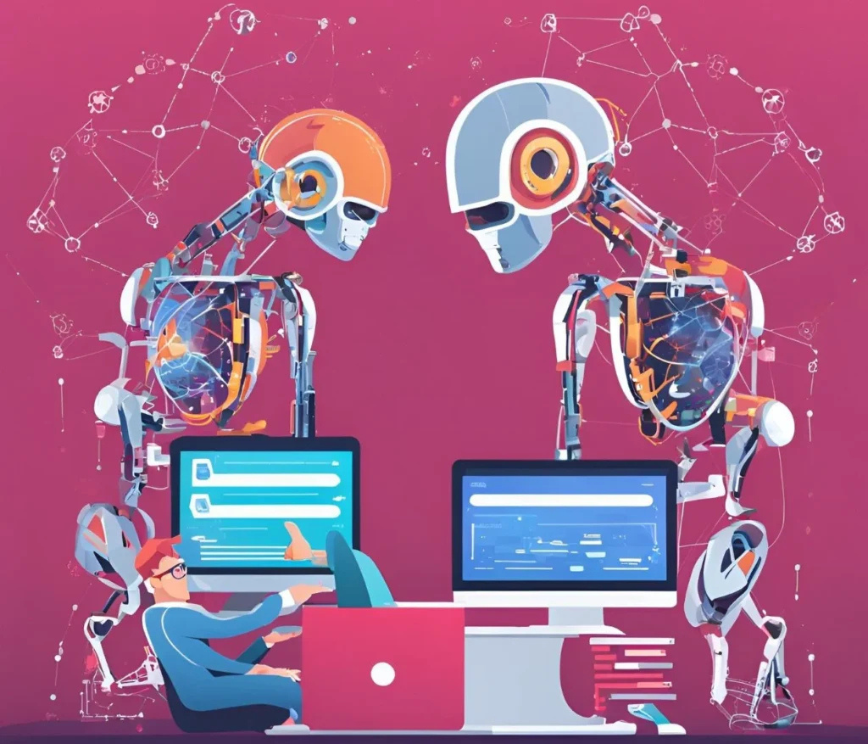
1. AI-Powered Website Builders
AI-powered website builders such as Wix ADI and Bookmark’s AiDA enable users to create websites without requiring coding knowledge. These tools analyze user preferences and generate a fully functional and aesthetically pleasing website in minutes. By automating the design process, AI helps businesses save time and costs associated with traditional web development.
www.quorawebsolution.com

Slide 5

2. Automated Code Generation
AI is revolutionizing coding by automating the development process. Platforms like GitHub Copilot and OpenAI’s ChatGPT assist developers by suggesting code snippets, identifying errors, and optimizing code structure. This reduces manual effort, enhances productivity, and minimizes human error.
www.quorawebsolution.com

Slide 6
3. AI-Based UI/UX Design Enhancements
AI analyzes user behavior and interactions to improve the design and functionality of websites. AI-driven tools, such as Adobe Sensei and Uizard, help designers create intuitive user interfaces by providing smart recommendations for layouts, colors, fonts, and element placements. AI also enables A/B testing automation, allowing designers to refine user experience based on data-driven insights.
4. Personalization and AI Chatbots
Personalization is a crucial aspect of modern website design, and AI makes it more effective. AI-driven recommendation engines, such as those used by Amazon and Netflix, analyze user behavior and preferences to display personalized content, product suggestions, and tailored marketing campaigns. Additionally, AI-powered chatbots like ChatGPT and Drift enhance customer engagement by providing real-time assistance and answering queries efficiently.
www.quorawebsolution.com

Slide 7
5. AI in SEO and Content Optimization
AI plays a significant role in improving website visibility through search engine optimization (SEO). AI-powered tools like SurferSEO, Clearscope, and MarketMuse analyze keywords, competitor content, and search trends to optimize content for better rankings. AI also helps in generating high-quality content, ensuring that websites stay relevant and engaging.
6. AI for Website Security and Performance Optimization
Cybersecurity is a growing concern for web developers, and AI helps mitigate risks by detecting and preventing cyber threats. AI-driven security tools, such as Darktrace and Imperva, use machine learning algorithms to identify vulnerabilities and prevent attacks in real time. Additionally, AI enhances website performance by optimizing load times, compressing images, and ensuring seamless navigation for users.
The Future of AI in Web Development
www.quorawebsolution.com

Slide 8
As AI technology continues to advance, its role in web development will expand even further. Here are some potential future trends:
Hyper-Personalized Websites: AI will enable websites to adapt dynamically to user behavior, preferences, and real-time interactions.
Voice and Visual Search Optimization: AI will enhance website accessibility by integrating voice search capabilities and visual search recognition.
AI-Generated Web Content: Advanced AI tools will generate blog posts, product descriptions, and social media content tailored to target audiences.
Automated Testing and Bug Fixing: AI will streamline website maintenance by automatically detecting and fixing bugs without human intervention.
www.quorawebsolution.com

Slide 9
Conclusion
AI is reshaping web development by making it faster, smarter, and more efficient. From automating coding and enhancing UI/UX design to improving SEO and cybersecurity, AI-driven technologies are transforming how websites are built and managed. As AI continues to evolve, businesses and developers must embrace these innovations to stay competitive in the digital landscape.
By leveraging AI in web development, companies can create smarter, more responsive, and user-friendly websites, ultimately enhancing customer experiences and driving business success.
The Ultimate Guide to Website Design and Development: Trends, Tools, and Best Practices for 2025
Introduction
www.quorawebsolution.com

Slide 10
Website design and development are continuously evolving, driven by technological advancements and changing user expectations. As we step into 2025, businesses and developers must stay updated with the latest trends, tools, and best practices to create high-performing, visually appealing, and user-friendly websites. This guide explores the essential elements of modern web design and development, helping you build a website that stands out in today’s competitive digital landscape.
Latest Trends in Website Design and Development
1. AI-Powered Web Design
Artificial Intelligence (AI) is transforming web design by automating tasks, generating code, and personalizing user experiences. AI-driven website builders, such as Wix ADI and Bookmark, allow users to create stunning sites without coding knowledge.
2. Dark Mode and Minimalist Aesthetics
www.quorawebsolution.com

Slide 11
Dark mode has gained popularity for its sleek appearance and reduced eye strain. Combined with minimalist design principles, websites in 2025 are expected to feature clean layouts, ample white space, and intuitive navigation.
3. Voice Search Optimization
With the rise of voice assistants like Alexa, Siri, and Google Assistant, optimizing websites for voice search is crucial. This involves using conversational keywords, structured data, and ensuring fast page load times.
4. Motion UI and Micro-Interactions
Adding subtle animations and interactive elements enhances user engagement. Motion UI helps guide users through a website while providing an enjoyable browsing experience.
5. Progressive Web Apps (PWAs)
PWAs combine the best of web and mobile apps, offering offline functionality, fast loading speeds, and a seamless user experience. More businesses are adopting PWAs to improve accessibility and performance.
www.quorawebsolution.com

Slide 12
Essential Tools for Website Design and Development
1. Website Builders and CMS Platforms
WordPress – A versatile CMS with thousands of plugins and themes.
Webflow – A visual web design tool for responsive sites.
Shopify – Best for e-commerce website development.
2. UI/UX Design Tools
Figma – Collaborative interface design tool.
Adobe XD – Prototyping and wireframing tool.
Canva – Easy-to-use design tool for beginners.
3. Frontend Development Frameworks
React.js – Efficient and flexible JavaScript library for building UI.
Vue.js – Progressive JavaScript framework.
www.quorawebsolution.com

Slide 13
Bootstrap – Responsive CSS framework for mobile-first design.
4. Backend Development Technologies
Node.js – Fast and scalable backend environment.
Django – Secure and powerful Python framework.
Laravel – Popular PHP framework for robust applications.
5. SEO and Performance Optimization Tools
Google PageSpeed Insights – Analyzes and improves website speed.
SEMrush – SEO and keyword research tool.
Yoast SEO – WordPress plugin for SEO optimization.
Best Practices for Website Design and Development in 2025
1. Mobile-First Design
www.quorawebsolution.com

Slide 14
With mobile browsing dominating, designing for smaller screens first ensures better responsiveness and usability.
2. Fast Loading Speeds
Slow websites lead to high bounce rates. Use optimized images, caching techniques, and a Content Delivery Network (CDN) to improve load times.
3. Accessibility and Inclusive Design
Ensure your website is accessible to all users, including those with disabilities, by following WCAG guidelines and adding features like alt text for images and keyboard navigation.
4. Cybersecurity Measures
With rising cyber threats, implement HTTPS, multi-factor authentication, and regular security audits to protect user data.
www.quorawebsolution.com

Slide 15
5. High-Quality Content Strategy
A successful website needs engaging, informative, and optimized content. Regular blog updates, multimedia integration, and clear calls to action help attract and retain visitors.
Conclusion
Website design and development in 2025 emphasize innovation, user experience, and performance. By adopting the latest trends, leveraging the right tools, and following best practices, businesses and developers can create websites that are visually appealing, functional, and future-proof. Stay ahead by continually learning and adapting to the ever-evolving digital landscape.
www.quorawebsolution.com

Slide 16
Quora Web Solution: Quora Web Solution is a trusted website development company based in Bangalore, India, offering a wide array of services to not only domestic but global clientele. Be it Website Design and Development, SEO services, Digital Marketing, Branding, App Development, Ecommerce Solution, and Logo Creation . Quora Web Solution has the best website developers offering top quality services and that is the reason why we are well known as one of the best Website Development Companies in Bangalore, India.
Visit Us - www.quorawebsolution.com
Call Us - +91 9986 056 909
Mail Us - info@quorawebsolutions.com
www.quorawebsolution.com

Slide 17

WORDPRESS DEVELOPMENT
ECOMMERCE DEVELOPMENT
PHP DEVELOPMENT
CMS DEVELOPMENT
DRUPAL DEVELOPMENT
WEBSITE SERVICES
WEBPORTAL DEVELOPMENT
MAGENTO DEVELOPMENT
WEBSITE DEVELOPMENT
JOOMLA DEVELOPMENT
SMALL BUSINESS DEVELOPMENT
CHEAP WEBSITE DEVELOPMENT
STATIC WEBSITE DEVELOPMENT
DYNAMIC WEBSITE DEVELOPMENT
WEBSITE DESIGN COMPANY
TOUR AND TRAVEL WEBSITE DEVELOPMENT
Services

