Slide 1



Quora Web Solution
Website Design and
Development
Company
Web Design & Web Development
Company in Bangalore, India
www.quorawebsolution.com
+91 9986 056 909
info@quorawebsolutions.com
24A, 1st Main Rd, Chandra Reddy
Layout, Koramangala 4th Block,
Koramangala, Bengaluru,
Karnataka 560034

Slide 2

The Digital Advantage: How Top-Tier Website Design and Development Companies Can Help You Thrive
www.quorawebsolution.com

Slide 3
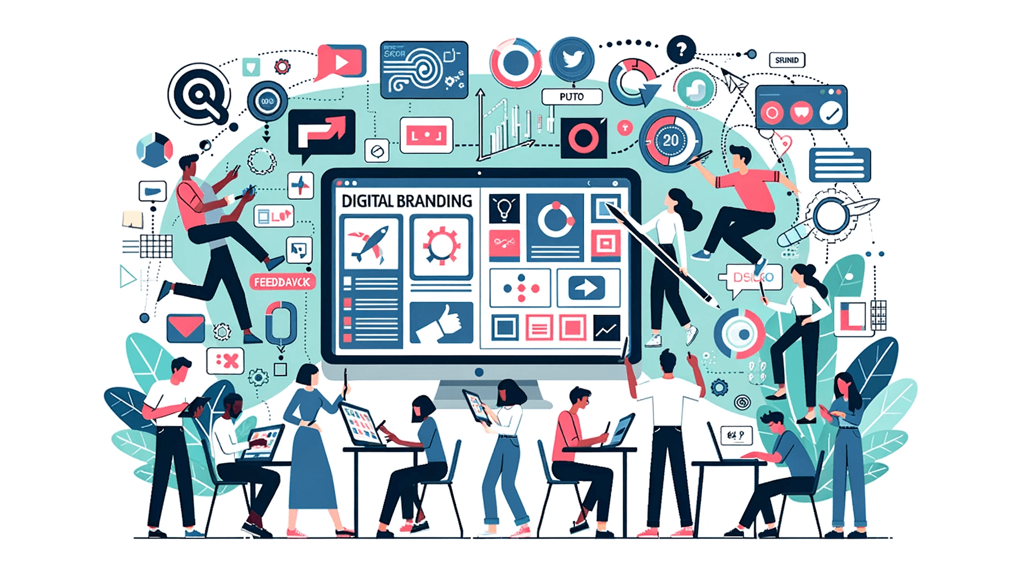
Your website is a vital tool for business success. Your website is your digital storefront.
www.quorawebsolution.com

Slide 4
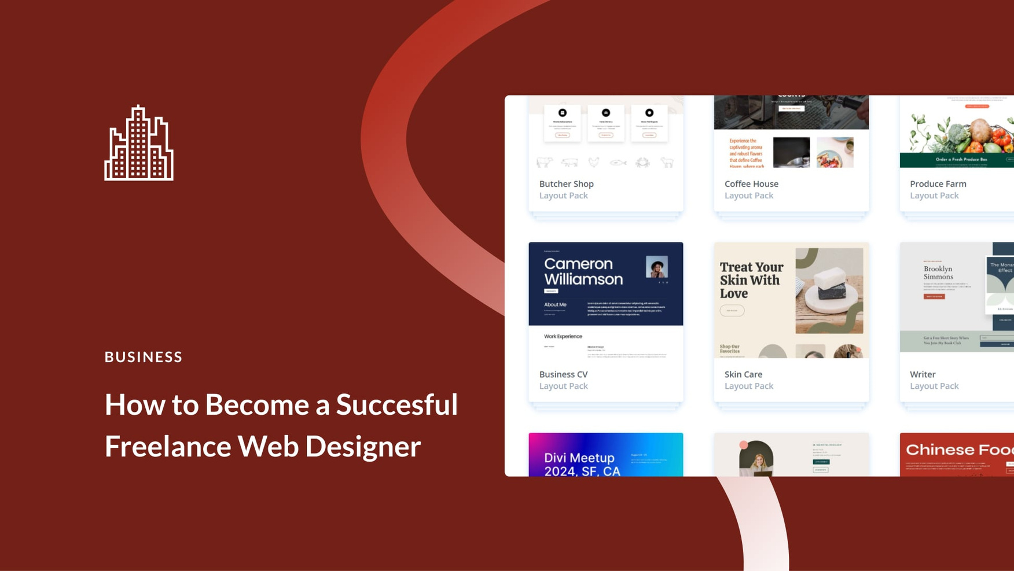
A well-designed and developed website can significantly impact your brand's reputation, customer engagement, and ultimately, your bottom line.
www.quorawebsolution.com

Slide 5
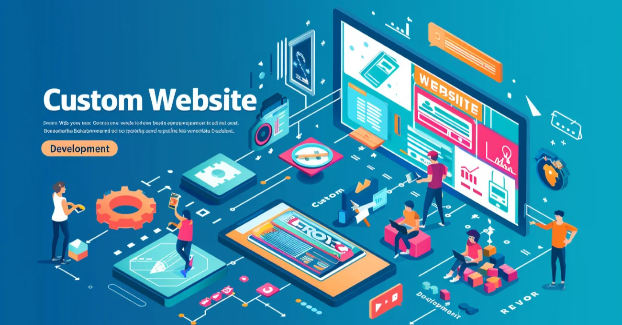
Why Partner with a Top-Tier Website Design and Development Company?
www.quorawebsolution.com

Slide 6
Top-tier website design and development companies possess the expertise and resources to create exceptional digital experiences. Here's how they can help your business thrive:
1. Enhanced Brand Image and Reputation
  Professionalism: A well-designed website signals professionalism and credibility to your audience.
  Visual Appeal: Stunning visuals and intuitive navigation create a positive first impression.
  Brand Consistency: Consistent branding across all digital platforms reinforces your brand identity.
2. Improved User Experience (UX)
  User-Centric Design: Websites designed with the user in mind are more likely to engage and convert visitors.
  Seamless Navigation: Easy-to-navigate websites reduce bounce rates and increase time on site.
  Mobile-First Design: Design for mobile devices first to ensure a seamless experience.
www.quorawebsolution.com

Slide 7
3. Boosted Search Engine Optimization (SEO)
  Keyword Optimization: Strategic keyword placement and optimization improve search engine visibility.
  Technical SEO: Proper website structure, fast loading times, and mobile-friendliness are crucial for SEO success.
  Content Marketing: High-quality, relevant content attracts organic traffic and builds authority.
4. Increased Sales and Conversions
  Clear Call-to-Actions: Effective CTAs guide visitors towards desired actions, such as making a purchase or signing up for a newsletter.
  E-commerce Integration: Seamless online shopping experiences drive sales and revenue.
  Lead Generation: Capturing visitor information through forms and pop-ups helps nurture leads.
www.quorawebsolution.com

Slide 8
5. Data-Driven Insights
  Analytics and Tracking: Monitor website performance and user behavior to make data-driven decisions.
  A/B Testing: Experiment with different design elements to optimize conversion rates.
  Performance Optimization: Continuously improve website speed and performance to enhance user experience.
6. Security and Protection
  Robust Security Measures: Protect your website and customer data from cyber threats.
  Regular Updates and Maintenance: Keep your website secure and up-to-date with the latest technologies.
  Disaster Recovery Planning: Implement strategies to minimize downtime and data loss.
www.quorawebsolution.com

Slide 9
Conclusion
By partnering with a top-tier website design and development company, you can unlock the full potential of your online presence. These experts can help you create a website that's both visually appealing and results-driven.
Remember, your website is your digital storefront. Make sure it's a welcoming and effective one.
Best Website Design and Development Companies: A Comprehensive Guide to Digital Success
In today's digital age, a well-designed and developed website is essential for businesses of all sizes. A strong online presence can significantly impact your brand's reputation, customer engagement, and ultimately, your bottom line.
Choosing the right website design and development company is crucial for your digital success.
www.quorawebsolution.com

Slide 10
Key Factors to Consider:
  Experience and Expertise: Look for a company with a proven track record and expertise in your industry.
  Portfolio and Case Studies: Review their portfolio and client testimonials.
  Design Capabilities: Ensure they can create visually appealing and user-friendly designs.
  Development Skills: Look for a company with expertise in various programming languages and frameworks.
  SEO and Digital Marketing Expertise: A strong understanding of SEO and digital marketing is crucial.
  Communication and Collaboration: Effective communication is key to a successful project.
  Pricing and Contracts: Get clear quotes and review the contract terms carefully.
www.quorawebsolution.com

Slide 11
Top Website Design and Development Companies:
  Company A: Renowned for innovative design and cutting-edge technology.
  Company B: Specializes in e-commerce solutions and helps businesses grow online.
  Company C: Offers a wide range of services, including web design, development, and SEO.
  Company D: Known for its expertise in creating high-performance websites.
  Company E: Focuses on user experience and accessibility.
Remember, a well-designed and developed website is an investment in your business's future. By carefully selecting a top-tier website design and development company, you can create a digital presence that drives growth and success.
www.quorawebsolution.com

Slide 12
Quora Web Solution: Quora Web Solution is a trusted website development company based in Bangalore, India, offering a wide array of services to not only domestic but global clientele. Be it Website Design and Development, SEO services, Digital Marketing, Branding, App Development, Ecommerce Solution, and Logo Creation . Quora Web Solution has the best website developers offering top quality services and that is the reason why we are well known as one of the best Website Development Companies in Bangalore, India.
Visit Us - www.quorawebsolution.com
Call Us - +91 9986 056 909
Mail Us - info@quorawebsolutions.com
www.quorawebsolution.com

Slide 13




Services
WORDPRESS DEVELOPMENT
ECOMMERCE DEVELOPMENT
PHP DEVELOPMENT
CMS DEVELOPMENT
DRUPAL DEVELOPMENT
WEBSITE SERVICES
WEBPORTAL DEVELOPMENT
MAGENTO DEVELOPMENT
WEBSITE DEVELOPMENT
JOOMLA DEVELOPMENT
SMALL BUSINESS DEVELOPMENT
CHEAP WEBSITE DEVELOPMENT
STATIC WEBSITE DEVELOPMENT
DYNAMIC WEBSITE DEVELOPMENT
WEBSITE DESIGN COMPANY
TOUR AND TRAVEL WEBSITE DEVELOPMENT

