Slide 1



Quora Web Solution
Website Design and
Development
Company
Web Design & Web Development
Company in Bangalore, India
www.quorawebsolution.com
+91 9986 056 909
info@quorawebsolutions.com
24A, 1st Main Rd, Chandra Reddy
Layout, Koramangala 4th Block,
Koramangala, Bengaluru,
Karnataka 560034

Slide 2

The Architects of the Internet: A Look at the Best Website Design and Development Firms
www.quorawebsolution.com

Slide 3
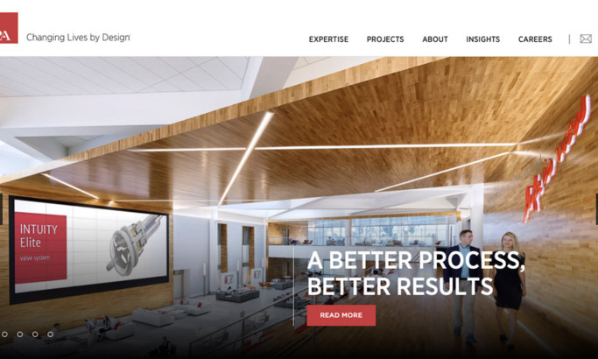
In today's digital age, a website is more than just an online presence; it's a digital storefront, a marketing tool, and a customer experience platform.
www.quorawebsolution.com

Slide 4

The quality of your website can significantly impact your brand's reputation, customer engagement, and ultimately, your bottom line.
www.quorawebsolution.com

Slide 5

To build a website that truly stands out, you need to partner with a skilled and experienced website design and development firm.
www.quorawebsolution.com

Slide 6
These firms are the architects of the internet, crafting digital experiences that captivate audiences and drive results.
Key Factors to Consider When Choosing a Firm
When selecting a website design and development firm, consider the following factors:
  Expertise and Experience: Look for a firm with a proven track record in your industry. Experienced developers understand the nuances of different sectors and can tailor their approach accordingly.
  Design Capabilities: A strong design team can create visually appealing and user-friendly websites. Consider the firm's portfolio to assess their design aesthetic and capabilities.
  Development Skills: A skilled development team is essential for building functional and efficient websites. Look for experience with the latest technologies and frameworks.
  SEO Expertise: A website that isn't optimized for search engines is unlikely to attract organic traffic. Ensure the firm has a strong understanding of SEO principles.
www.quorawebsolution.com

Slide 7
  Project Management: Effective project management is crucial for delivering projects on time and within budget. A reputable firm will have a well-defined project management process.
  Communication Skills: Clear and consistent communication is essential for a successful client-agency relationship. The firm should be responsive and proactive in addressing your needs.
  Pricing and Contracts: Understand the firm's pricing structure and contract terms. Be sure to review the contract carefully to avoid any surprises.
Top Website Design and Development Firms
While the best firm for your needs may vary, here are a few industry-leading companies known for their exceptional work:
1. [Firm 1 Name]
www.quorawebsolution.com

Slide 8
  Specialization: [Specialization, e.g., e-commerce, healthcare, technology]
  Strengths: [Highlight key strengths, such as design innovation, SEO expertise, or customer support]
2. [Firm 2 Name]
  Specialization: [Specialization, e.g., digital marketing, branding, web development]
  Strengths: [Highlight key strengths, such as agile development methodologies, user experience design, or content strategy]
3. [Firm 3 Name]
  Specialization: [Specialization, e.g., mobile app development, cloud solutions, data analytics]
  Strengths: [Highlight key strengths, such as cutting-edge technology, scalability, or security expertise]
4. [Firm 4 Name]
  Specialization: [Specialization, e.g., creative design, digital transformation, e-learning]
www.quorawebsolution.com

Slide 9
  Strengths: [Highlight key strengths, such as storytelling, brand identity, or accessibility]
5. [Firm 5 Name]
  Specialization: [Specialization, e.g., enterprise solutions, software development, AI and machine learning]
  Strengths: [Highlight key strengths, such as complex system integration, data-driven decision-making, or innovation]
Remember, the best way to choose a website design and development firm is to do your research and ask the right questions. By partnering with a reputable firm, you can create a digital presence that drives results and helps your business thrive.
The Digital Alchemysts: How Top-Tier Web Development Companies Turn Ideas into Reality
www.quorawebsolution.com

Slide 10
In the realm of the digital age, where information flows ceaselessly and innovation is the norm, top-tier web development companies have emerged as the modern-day alchemists. They transform raw ideas into tangible, interactive digital experiences, turning the intangible into the tangible.
The Alchemy of Web Development
These companies possess a unique blend of creativity, technical expertise, and strategic thinking. They understand the delicate balance between aesthetics and functionality, ensuring that every pixel serves a purpose. Their process involves a meticulous approach, from the initial concept to the final deployment:
  Ideation and Strategy: The journey begins with a spark of an idea. Top-tier companies collaborate closely with clients to understand their vision and goals. They then translate these aspirations into a comprehensive digital strategy.
www.quorawebsolution.com

Slide 11
  Design and User Experience (UX): Once the strategy is in place, the design phase commences. Designers create intuitive and visually appealing interfaces. They prioritize user experience, ensuring seamless navigation and a delightful interaction.
  Development and Coding: This is where the magic truly happens. Skilled developers bring the design to life, writing code.They leverage cutting-edge technologies to build robust and scalable websites.
  Testing and Quality Assurance: Rigorous testing is essential to identify and rectify any bugs or performance issues. Quality assurance teams meticulously scrutinize every aspect of the website to ensure a flawless user experience.
  Deployment and Launch: Once the website is perfected, it's time to deploy it to the live environment. Top-tier companies employ seamless deployment strategies to minimize downtime and ensure a smooth transition.
www.quorawebsolution.com

Slide 12
  Maintenance and Optimization: Ongoing maintenance and optimization are crucial to keep the website performing optimally. These companies provide ongoing support and updates to ensure the website performs optimally.
The Impact of Top-Tier Web Development
Top-tier web development companies play a pivotal role in shaping the digital landscape. Their work has a profound impact on businesses, organizations, and individuals alike:
  Enhanced Brand Image: A well-designed and functional website can significantly elevate a brand's image and reputation.
  Increased Online Visibility: SEO-optimized websites attract more organic traffic, leading to higher visibility and better search engine rankings.
www.quorawebsolution.com

Slide 13
  Improved Customer Experience: User-friendly websites create a positive customer experience, fostering loyalty and driving conversions.
  Boosted Sales and Revenue: A well-crafted e-commerce website can drive sales and increase revenue.
  Competitive Advantage: A cutting-edge digital presence can give businesses a competitive edge in the market.
By partnering with a top-tier web development company, businesses can unlock the full potential of the digital world. These companies are the architects of the internet, shaping the future one website at a time.
www.quorawebsolution.com

Slide 14
Quora Web Solution: Quora Web Solution is a trusted website development company based in Bangalore, India, offering a wide array of services to not only domestic but global clientele. Be it Website Design and Development, SEO services, Digital Marketing, Branding, App Development, Ecommerce Solution, and Logo Creation . Quora Web Solution has the best website developers offering top quality services and that is the reason why we are well known as one of the best Website Development Companies in Bangalore, India.
Visit Us - www.quorawebsolution.com
Call Us - +91 9986 056 909
Mail Us - info@quorawebsolutions.com
www.quorawebsolution.com

Slide 15




Services
WORDPRESS DEVELOPMENT
ECOMMERCE DEVELOPMENT
PHP DEVELOPMENT
CMS DEVELOPMENT
DRUPAL DEVELOPMENT
WEBSITE SERVICES
WEBPORTAL DEVELOPMENT
MAGENTO DEVELOPMENT
WEBSITE DEVELOPMENT
JOOMLA DEVELOPMENT
SMALL BUSINESS DEVELOPMENT
CHEAP WEBSITE DEVELOPMENT
STATIC WEBSITE DEVELOPMENT
DYNAMIC WEBSITE DEVELOPMENT
WEBSITE DESIGN COMPANY
TOUR AND TRAVEL WEBSITE DEVELOPMENT

