Slide 1

Small Scale Milk Pasteurizers with MicroThermics
Small Scale Milk Pasteurizers

Slide 2
Introduction
In today’s dynamic food and beverage industry, small-scale producers and dairy enthusiasts are increasingly looking for efficient, cost-effective solutions to ensure product safety and quality. One of the critical processes in dairy production is pasteurization, a heat treatment process that kills harmful microorganisms in milk. Enter the small scale milk pasteurizer, a game-changer for artisanal and small-scale dairy producers. Among the industry leaders, MicroThermics stands out, offering innovative pasteurization solutions that combine efficiency, reliability, and user-friendliness.

Slide 3
Why Choose Small Scale Milk Pasteurizers?
Small-scale milk pasteurizers are designed to cater to the needs of small dairy farms, local creameries, and even educational institutions. They offer several advantages:
Cost-Effectiveness: Large-scale pasteurization equipment can be prohibitively expensive for small producers. Small-scale pasteurizers are more affordable while still offering robust functionality.
Efficiency: These machines are designed to pasteurize smaller batches of milk efficiently, reducing waste and ensuring fresh, high-quality products.

Slide 4
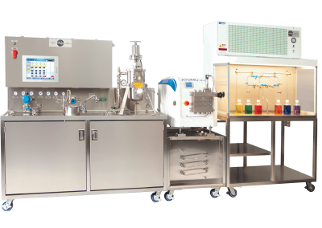
Ease of Use:
User-friendly interfaces and automated processes make these pasteurizers easy to operate, even for those with minimal technical expertise.
Versatility:
Small-scale pasteurizers can handle various dairy products, including milk, cream, yogurt, and cheese, allowing producers to diversify their offerings.

Slide 5
MicroThermics: A Leader in Pasteurization Technology
MicroThermics is a renowned name in the field of thermal processing, providing state-of-the-art solutions tailored for small-scale operations. Their small-scale milk pasteurizers exemplify innovation and reliability. Here’s why MicroThermics stands out:
Advanced Technology: MicroThermics incorporates cutting-edge technology to ensure precise tempeature control and consistent pasteurization, crucial for product safety and quality.
Customization: Understanding that every dairy operation is unique, MicroThermics offers customizable solutions to meet specific needs, whether it’s adjusting processing temperatures or accommodating different milk volumes.

Slide 6
Real-World Applications
Small-scale milk pasteurizers from MicroThermics are ideal for a range of applications:
Artisanal Dairy Producers: Small dairy farms can produce pasteurized milk and dairy products on-site, maintaining control over quality and flavor.
Educational Institutions: Schools and universities with agricultural programs can use these pasteurizers for teaching and research purposes.
Start-ups and Local Brands: New dairy ventures can experiment and innovate without the high overhead costs associated with large-scale equipment.

Slide 7
Contact Us
3216–102 Wellington Ct. Raleigh, NC 27615 USA
Phone: 9198788045
Email: info@microthermics.com
https://www.linkedin.com/company/microthermics-inc
https://www.facebook.com/microthermics
https://twitter.com/microthermics
https://microthermics.com/

