Slide 1


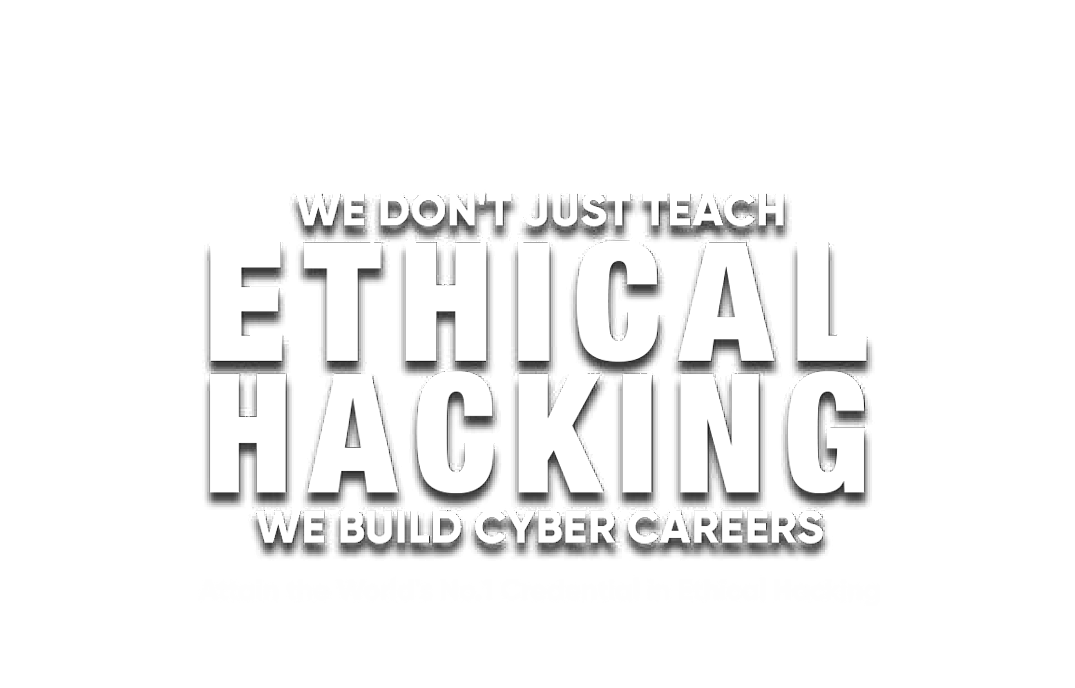

EC-Council
www.blitzacademy.org

Slide 2



Slide 3







Build Your Career
With The Most in- Demand Ethical Hacking Certification Program In The WORLD
The World’s No.1 Ethical hacking certification
A Structured Professional Course For Aspiring Cyber Professionals
Work Anywhere With CEH - Its Globally Recogonized
Comprehensive Program To Master The 5 Phases Of Ethical Hacking Hands On Learning With CyberQTM Labs
Flexible Learning Options : Live, Online, or Hybrid

Slide 4
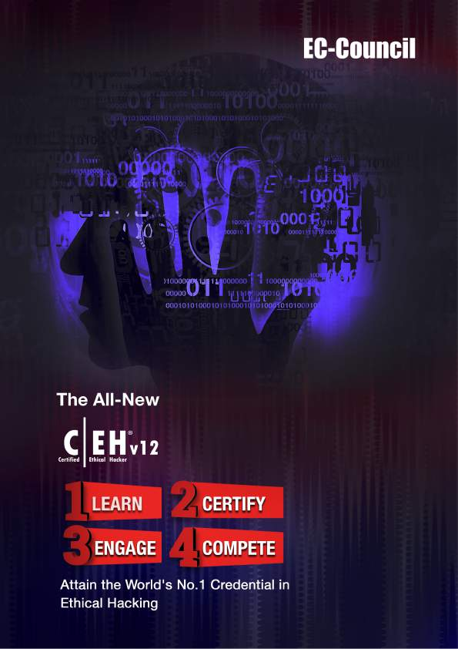
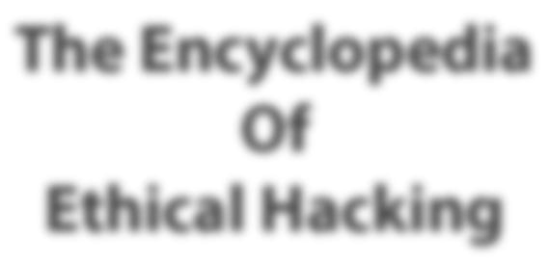
The Encyclopedia Of
Ethical Hacking

Slide 5




Build your career with the most in-demand cybersecurity
in the world:
THE CERTIFIED ETHICAL HACKER (CEH)
other critical data on secured systems. A CEH
The World’s No. 1 Ethical Hacking
Ranked #1
In Ethical Hacking
CEH Ranks 4th
CEH v12
www.eccouncil.org/ceh
01

Slide 6
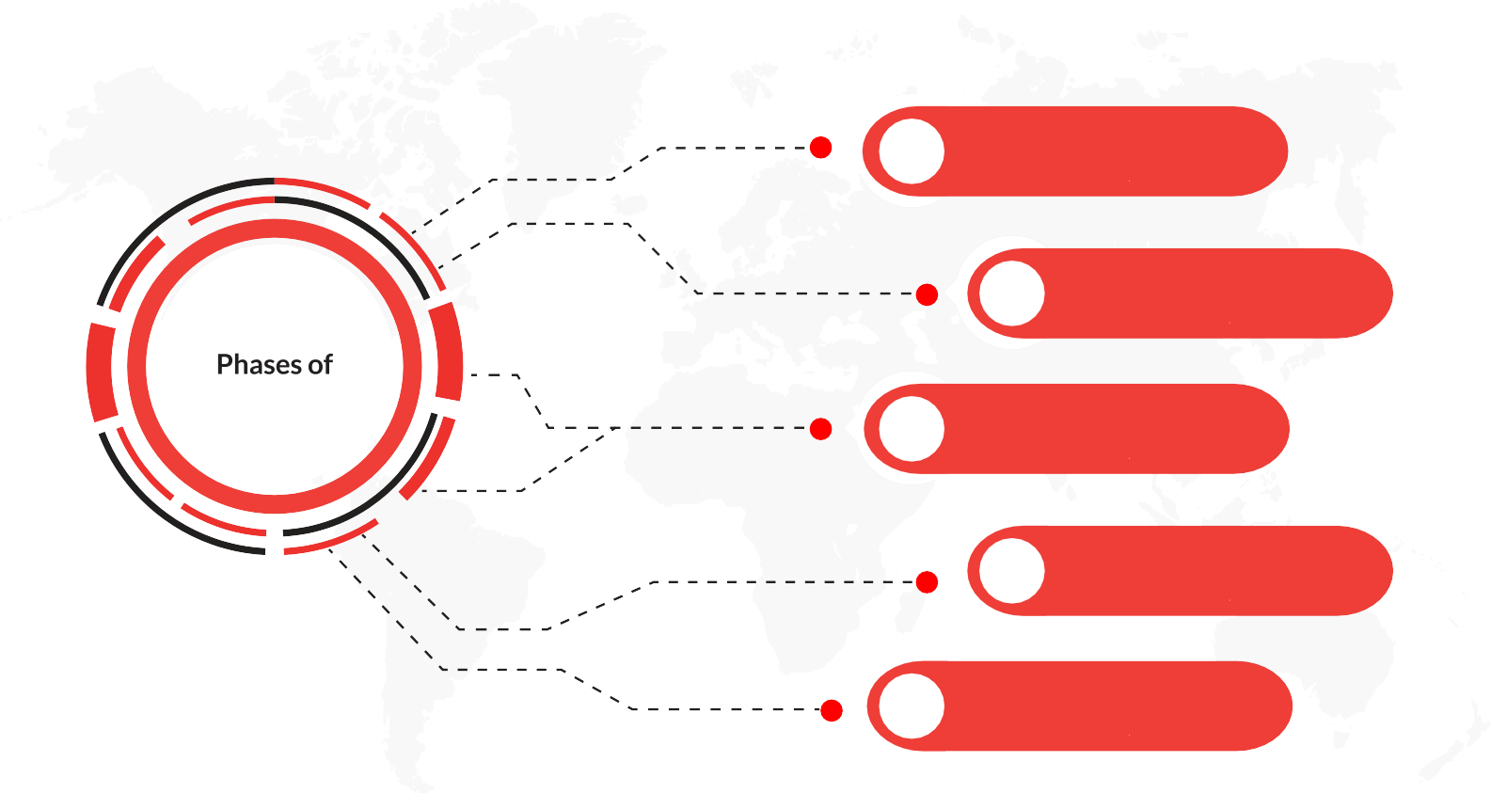
CEH
1
RECONNAISSANCE
5
Ethical Hacking
2
SCANNING
3
GAINING ACCESS
4
MAINTAINING ACCESS
5
COVERING TRACKS
The CEH
CEH v12
www.eccouncil.org/ceh
02

Slide 7






CEH
The CEH
Gain Skills
Gain Recognition
industry’s most hands-on lab and
Gain Experience
TM
Gain Respect
CEH v12
www.eccouncil.org/ceh

Slide 8






The CEH
CEH
Hacking and Prepare to Take the CEH
Scanning Networks
countermeasures.
CEH v12
www.eccouncil.org/ceh
04

Slide 9





-
Malware Threats
countermeasures.
Social Engineering
Session Hijacking
11
and countermeasures.
CEH v12
www.eccouncil.org/ceh
05

Slide 10




14
15
Hacking Wireless Networks
IoT Hacking
CEH v12
www.eccouncil.org/ceh
06

Slide 11


HANDS-ON LEARNING LABS
CEH v12
www.eccouncil.org/ceh
07

Slide 12


Attain
Mastery!
v12
Ethical Hacker
Certified
CEH v12
www.eccouncil.org/ceh
08

Slide 13

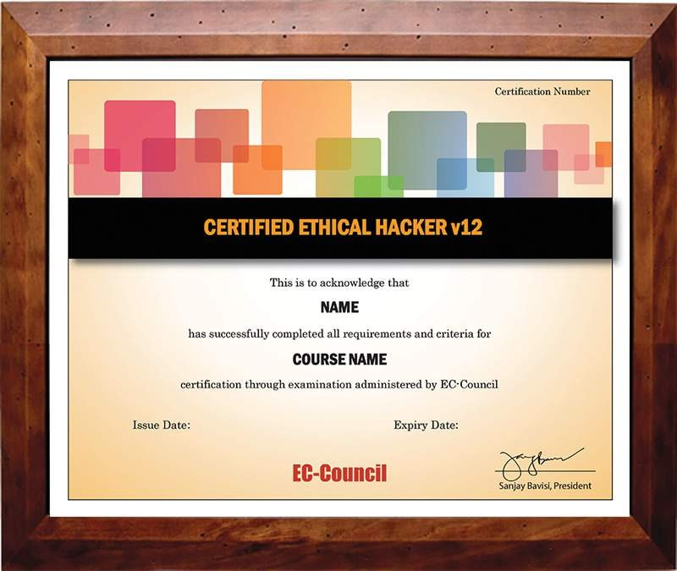
CEH
The CEH
CEH
CEH v12
www.eccouncil.org/ceh
09

Slide 14


The CEH
CEH
New to CEH
CEH
CEH
CEH v12
www.eccouncil.org/ceh
10

Slide 15












Reconnaissance
Malware Threats
Vulnerability Analysis
PHASE 1
PHASE 2
PHASE 4
PHASE 3
CEH v12
www.eccouncil.org/ceh
11

Slide 16


The CEH
CEH
Month
Skill Challenge
CEH v12
www.eccouncil.org/ceh
12

Slide 17









CEH
Ransomware/
Application
Hardening
www.eccouncil.org/ceh

Slide 18


CEH v12
7. Global CEH
2. Diamond Model of Intrusion Analysis
www.eccouncil.org/ceh

Slide 19





Windows 11
Android
3000+ | 1900+
3500+ | 220
519 | 20 Refreshed Modules
www.eccouncil.org/ceh

Slide 20




CEH
Cybersecurity Auditor
Cyber Defense Analyst
Vulnerability Assessment Analyst
Cybersecurity Consultant
www.eccouncil.org/ceh

Slide 21
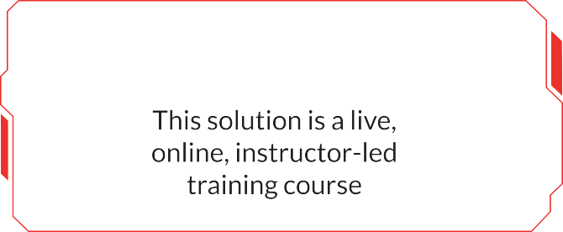
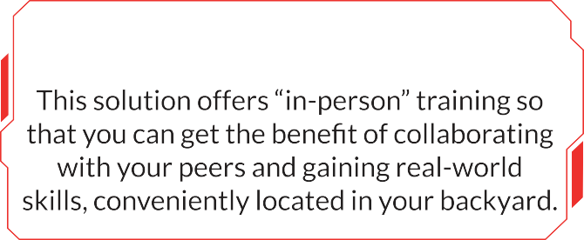
CEH
CEH
Exam Title:
Exam Code:
Number of Questions:
125
Duration:
Availability: Test Format: Passing Score:
Training Options
iLearn (Self-Study)
iWeek (Live Online)
Master Class
Training Partner (In Person)
class instructors and collaborate with
www.eccouncil.org/ceh

Slide 22










Trusted By
FORTUNE 500 COMPANIES
CEH v12
Recognition / Endorsement / Mapping
100% mapping to NICE Workforce Framework for Cybersecurity
National Infocomm
CEH v12
www.eccouncil.org/ceh
18

Slide 23










CEH
“Skills from the CEH program have evolved and are valuable.”
“Knowledge I gained from CEH
“Helping organization investigating SolarWinds hack, wouldn’t havebeen possiblewithout CEH.”
to step into a role as a security engineer and penetration tester.”
booster and helped land me a job on a Red Team in the government sector.”
“CEH Made me an authoritative expert on security discussions with our clients.”
“CEH helped me be able to understand exactly what I was
“CEH has helped me to work on mobile devices and AppSec - Pen testing and reverse engineering.”
talk the talk, CEH walks the walk and is recognized by the department of defense.”
CEH develops a “think outside the box” approach that you cannot get from other skills.
CEH v12
www.eccouncil.org/ceh
19

Slide 24


CEH
CEH
CEH
1 In Every 2
CEH
97%
CEH
97%
CEH
95%
Chose CEH
93%
Said That CEH
92%
Ethical Hacking Skills.
CEH
92%
Reported That CEH
88%
Considered CEH
85%
Credited CEH
80%
CEH .
CEH
CEH v12
www.eccouncil.org/ceh
20

Slide 25




About
We
CEH v12
www.eccouncil.org/ceh
21

Slide 26
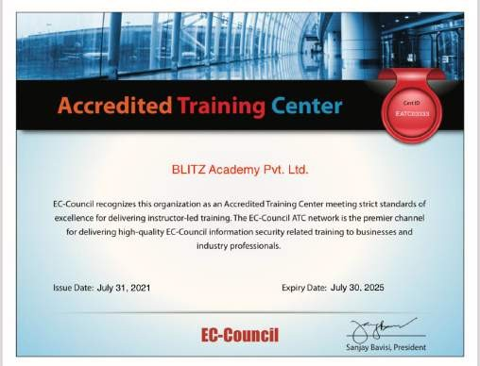





Hack Out Your Career
@blitzacademy

