Slide 1

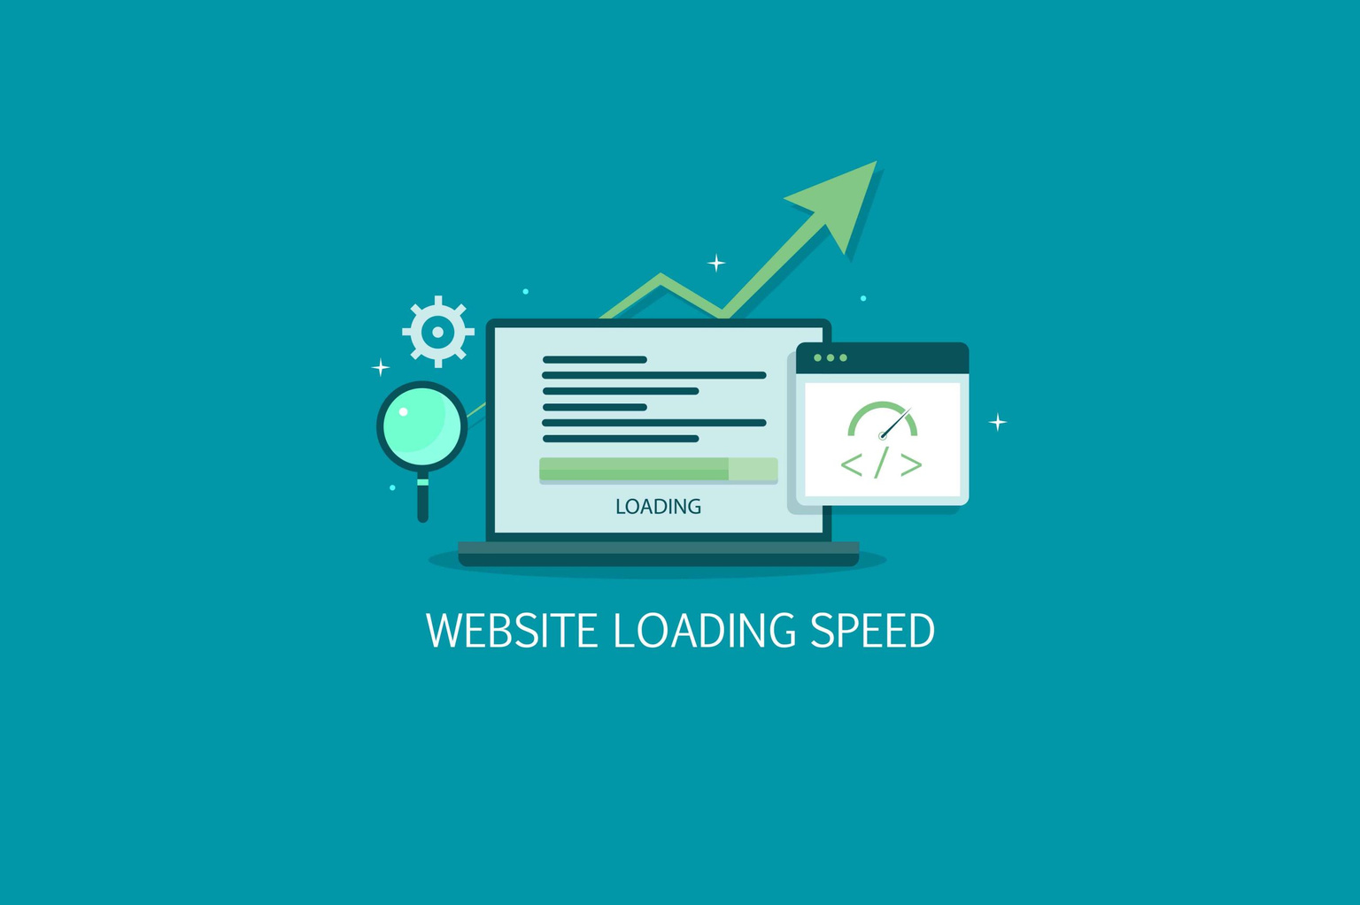
Quora Web Solution
Website Design and
Development
Company
Web Design & Web Development
Company in Bangalore, India
www.quorawebsolution.com
+91 9986 056 909
info@quorawebsolutions.com
24A, 1st Main Rd, Chandra Reddy
Layout, Koramangala 4th Block,
Koramangala, Bengaluru,
Karnataka 560034

Slide 2

How Website Speed and Performance Impact Your Business: Optimization Tips for a Faster Website
Introduction
www.quorawebsolution.com

Slide 3

In today’s digital world, website speed and performance play a critical role in user experience, search engine rankings, and business success.
www.quorawebsolution.com

Slide 4

A slow-loading website can lead to high bounce rates, lost revenue, and lower search engine rankings.
www.quorawebsolution.com

Slide 5

On the other hand, a fast website improves engagement, enhances customer satisfaction, and boosts conversion rates.
www.quorawebsolution.com

Slide 6
In this article, we will explore how website speed impacts your business and provide essential optimization tips to ensure a fast and efficient website.
Why Website Speed Matters
1. User Experience (UX)
Website visitors expect pages to load quickly. Research indicates that users tend to leave websites that take longer than 3 seconds to load, significantly impacting engagement and retention rates. A slow website leads to frustration and a poor user experience, causing potential customers to leave and seek alternatives.
2. Search Engine Rankings (SEO)
Google considers page speed as a ranking factor for both desktop and mobile searches. Faster websites are favored in search results, leading to higher visibility and increased organic traffic.
www.quorawebsolution.com

Slide 7
Google’s Core Web Vitals metrics specifically measure page speed, interactivity, and visual stability to assess overall performance.
3. Conversion Rates & Revenue
Research suggests that even a one-second delay in page load time can decrease conversions by as much as 7%, significantly impacting revenue potential. Faster websites encourage users to stay longer, explore more, and complete actions such as making purchases, filling out forms, or subscribing to services.
4. Bounce Rate Reduction
Bounce rate refers to the percentage of visitors who leave a site after viewing just one page. Slow websites often have higher bounce rates because users lose patience. Optimizing load time helps retain visitors and encourages them to explore more pages.
www.quorawebsolution.com

Slide 8
5. Mobile Experience & Accessibility
With mobile traffic surpassing desktop usage, a fast-loading mobile site is essential. Google’s Mobile-First Index prioritizes mobile performance, making it crucial for businesses to optimize speed for smartphones and tablets.
Essential Optimization Tips for Faster Website Performance
1. Optimize Images
Large images slow down page loading times. Use image compression tools like TinyPNG, JPEGoptim, or WebP format to reduce file sizes without compromising quality. Utilize lazy loading techniques to ensure images are loaded only when they come into the user's viewport, reducing initial page load time and improving performance.
www.quorawebsolution.com

Slide 9
2. Enable Browser Caching
Caching stores static files (like images, CSS, and JavaScript) on users' browsers, reducing the need to reload them every time they visit the site. Configure caching using plugins (for WordPress) or update server settings for improved performance.
3. Minify CSS, JavaScript, and HTML
Remove unnecessary characters, spaces, and comments from code to make it lighter and faster. Use tools like UglifyJS, CSSNano, or online minification tools to streamline your website’s files.
4. Use a Content Delivery Network (CDN)
A Content Delivery Network (CDN) distributes your website’s assets across multiple geographically dispersed servers, reducing latency and improving load times for users regardless of their location. This minimizes latency and accelerates page load speed, especially for global audiences.
5. Choose a Fast and Reliable Web Hosting Provider
www.quorawebsolution.com

Slide 10
Your hosting provider significantly impacts your site speed. Opt for high-performance hosting solutions such as VPS (Virtual Private Server), dedicated hosting, or cloud hosting instead of shared hosting. Providers like SiteGround, Kinsta, or Cloudways offer optimized hosting for speed.
6. Reduce HTTP Requests
Each element on a web page (images, scripts, stylesheets) requires an HTTP request. Reducing the number of requests by combining CSS and JavaScript files, using CSS sprites, and eliminating unnecessary elements helps improve load times.
7. Implement Gzip Compression
Gzip compresses website files before sending them to the browser, reducing their size and improving loading speed. Most web servers support Gzip compression and can be enabled via .htaccess or server settings.
8. Optimize Database Performance
www.quorawebsolution.com

Slide 11
For websites using databases (like WordPress or eCommerce platforms), optimizing database queries, cleaning up old revisions, and using database caching plugins like WP-Optimize can enhance performance.
9. Use Asynchronous Loading for JavaScript
Loading JavaScript synchronously can delay the rendering of other elements. By using asynchronous loading (async and defer attributes), scripts load in parallel, preventing unnecessary delays.
10. Monitor and Analyze Website Performance
Regularly check your website’s speed using tools like:
Google PageSpeed Insights (analyzes performance and provides optimization suggestions)
GTmetrix (detailed performance reports and recommendations)
Pingdom (measures page speed and uptime)
www.quorawebsolution.com

Slide 12
WebPageTest (detailed insights on load performance)
Conclusion
Website speed and performance directly impact user experience, SEO, and business revenue. By implementing these optimization techniques, businesses can improve site speed, enhance engagement, and maximize conversions. A fast-loading website not only benefits visitors but also boosts search rankings, ensuring long-term digital success. Start optimizing today to stay ahead of the competition!
The Ultimate Guide to Website Design and Development: How to Create a Stunning, High-Performing Website for Your Business
www.quorawebsolution.com

Slide 13
Introduction
In the digital age, a well-designed and high-performing website is essential for business success. Whether you're launching a new business or revamping an existing website, understanding the key principles of web design and development can help you create an engaging, functional, and visually appealing site. This guide will walk you through the crucial aspects of website design and development, ensuring your site not only looks great but also drives traffic and conversions.
Planning Your Website
1. Define Your Goals
Before diving into design and development, outline the purpose of your website. Ask yourself:
What is the primary goal of the website? (e.g., lead generation, sales, brand awareness)
Who is the target audience?
www.quorawebsolution.com

Slide 14
What key features and functionalities are required?
2. Research Competitors
Analyzing competitor websites can provide insights into industry standards, user expectations, and design trends. Identify elements that work well and areas where you can improve to stand out.
3. Choose the Right Platform
Select a content management system (CMS) or development platform based on your needs. Popular options include:
WordPress – Flexible, SEO-friendly, and customizable with plugins.
Shopify – Ideal for e-commerce businesses.
Wix/Squarespace – User-friendly website builders for small businesses.
www.quorawebsolution.com

Slide 15
Custom Development – Tailored solutions for unique business needs.
Website Design Principles
1. User Experience (UX) and User Interface (UI)
A great website prioritizes both UX and UI to create a seamless and enjoyable experience. Consider:
Navigation: Ensure menus are intuitive and easy to use.
Mobile Responsiveness: Optimize the site for all devices.
Fast Load Times: Reduce unnecessary elements that slow down performance.
2. Visual Appeal and Branding
Your website should reflect your brand identity. Use:
A consistent color scheme and typography.
High-quality images and graphics.
www.quorawebsolution.com

Slide 16
A visually engaging layout that balances text and media.
3. Content Strategy
Content is king in website design. Focus on:
Clear and concise messaging.
Compelling call-to-actions (CTAs) to drive user engagement.
SEO-friendly content that improves search rankings.
Development Best Practices
1. Mobile-First Development
With mobile traffic surpassing desktop usage, ensure your website is designed for smaller screens first, then scaled up for desktops.
2. SEO Optimization
Improve search engine visibility by:
www.quorawebsolution.com

Slide 17
Using descriptive URLs and meta tags.
Optimizing images and multimedia.
Implementing schema markup for better indexing.
3. Website Speed and Performance
A slow website can deter visitors. Enhance speed by:
Using caching techniques.
Minimizing HTTP requests.
Compressing images and enabling lazy loading.
4. Security Measures
Protect your website and user data by:
Installing an SSL certificate.
www.quorawebsolution.com

Slide 18
Keeping plugins and software up to date.
Implementing strong password policies and security plugins.
Essential Website Features
1. Contact Forms and Chatbots
Enable easy communication by adding:
Contact forms for inquiries.
Live chat or AI chatbots for instant support.
2. E-Commerce Functionality
For online stores, ensure you include:
Secure payment gateways.
www.quorawebsolution.com

Slide 19
Easy-to-navigate product pages.
A seamless checkout process.
3. Social Media Integration
Enhance brand reach by linking social media profiles and embedding sharing buttons on content pages.
Website Maintenance and Updates
Launching your site is just the beginning. Regular maintenance ensures optimal performance:
Monitor analytics to track user behavior.
Update content regularly to keep information relevant.
Fix broken links and update plugins/themes for security.
Conclusion
A well-designed and high-performing website is crucial for business growth.
www.quorawebsolution.com

Slide 20
By following the principles of effective website design and development, you can create a site that not only looks great but also converts visitors into loyal customers. Start planning your website today and set the foundation for long-term digital success!
www.quorawebsolution.com

Slide 21
Quora Web Solution: Quora Web Solution is a trusted website development company based in Bangalore, India, offering a wide array of services to not only domestic but global clientele. Be it Website Design and Development, SEO services, Digital Marketing, Branding, App Development, Ecommerce Solution, and Logo Creation . Quora Web Solution has the best website developers offering top quality services and that is the reason why we are well known as one of the best Website Development Companies in Bangalore, India.
Visit Us - www.quorawebsolution.com
Call Us - +91 9986 056 909
Mail Us - info@quorawebsolutions.com
www.quorawebsolution.com

Slide 22

WORDPRESS DEVELOPMENT
ECOMMERCE DEVELOPMENT
PHP DEVELOPMENT
CMS DEVELOPMENT
DRUPAL DEVELOPMENT
WEBSITE SERVICES
WEBPORTAL DEVELOPMENT
MAGENTO DEVELOPMENT
WEBSITE DEVELOPMENT
JOOMLA DEVELOPMENT
SMALL BUSINESS DEVELOPMENT
CHEAP WEBSITE DEVELOPMENT
STATIC WEBSITE DEVELOPMENT
DYNAMIC WEBSITE DEVELOPMENT
WEBSITE DESIGN COMPANY
TOUR AND TRAVEL WEBSITE DEVELOPMENT
Services

