Slide 1



Quora Web Solution
Website Design and
Development
Company
Web Design & Web Development
Company in Bangalore, India
www.quorawebsolution.com
+91 9986 056 909
info@quorawebsolutions.com
24A, 1st Main Rd, Chandra Reddy
Layout, Koramangala 4th Block,
Koramangala, Bengaluru,
Karnataka 560034

Slide 2
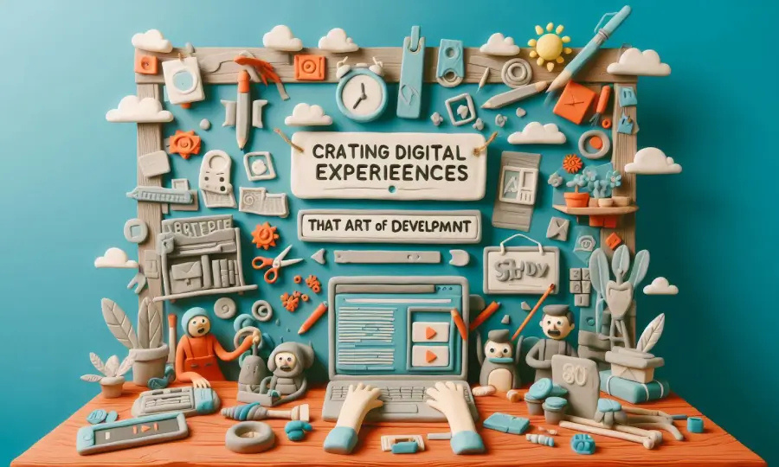
Crafting Digital Experiences: A Guide to Website Design and Development
In today's digital age, a well-designed website is essential for businesses of all sizes.
www.quorawebsolution.com

Slide 3

It's the first impression you make on potential customers, and it can significantly impact your brand's reputation and bottom line.
www.quorawebsolution.com

Slide 4
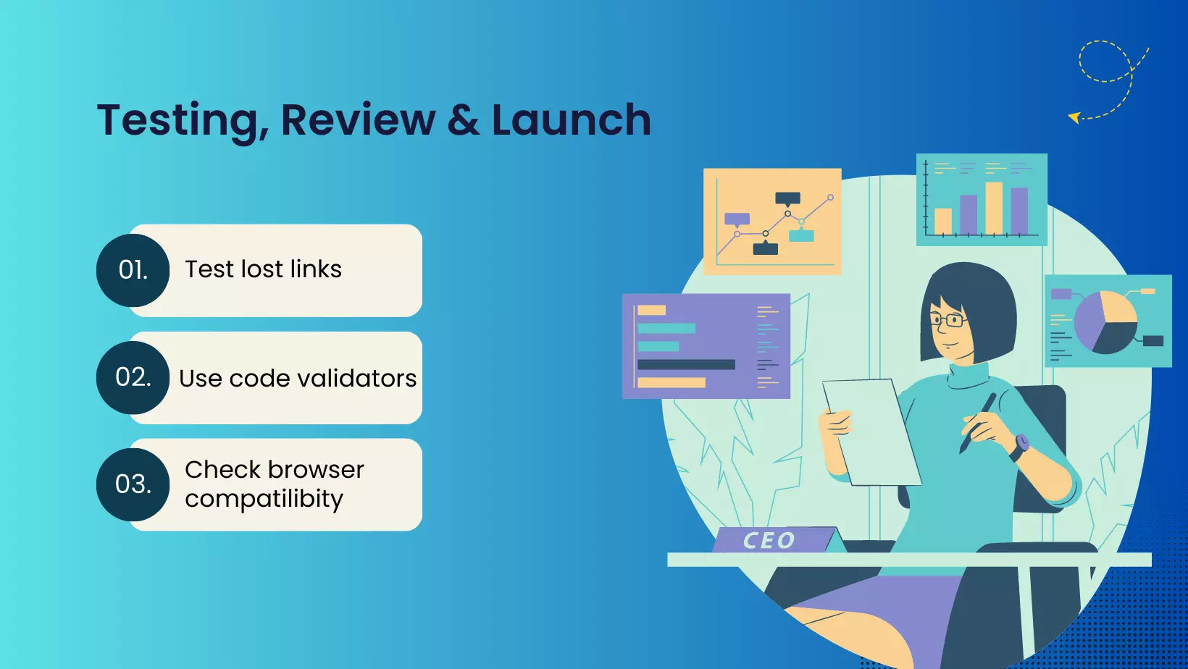
What is Website Design and Development?
www.quorawebsolution.com

Slide 5

Website design and development is a collaborative process that involves creating, building, and maintaining websites.
www.quorawebsolution.com

Slide 6
It encompasses a wide range of skills, including:
  UI/UX Design: This focuses on creating user-friendly and visually appealing interfaces.
  Front-End Development: This involves building the visible parts of a website using HTML, CSS, and JavaScript.
  Back-End Development: This focuses on the server-side of a website, including databases and server-side logic.
Why is Website Design and Development Important?
  First Impressions Matter: Your website is often the first point of contact with potential customers. A well-designed website can create a positive first impression and encourage visitors to stay longer.
  Brand Building: A consistent brand identity across all platforms, including your website, helps build trust and recognition.
  Enhanced User Experience: A user-friendly website with easy navigation and fast loading times can significantly improve user experience.
  Increased Online Visibility: A well-optimized website can improve your search engine rankings, making it easier for potential customers to find you.
www.quorawebsolution.com

Slide 7
  Improved Conversion Rates: A well-designed website can guide visitors towards desired actions, such as making a purchase or signing up for a newsletter.
Key Considerations for Website Design and Development:
  Responsive Design: Make your website accessible on all devices.
  Fast Loading Times: Optimize your website's performance to reduce loading times and improve user experience.
  Clear and Concise Content: Use clear and concise language that is easy to understand.
  Strong Call-to-Actions: Guide visitors towards desired actions with clear and compelling calls-to-action.
  Secure and Reliable Hosting: Choose a reliable hosting provider to ensure your website is always up and running.
  Regular Maintenance and Updates: Keep your website up-to-date with the latest security patches and software updates.
Partner with Us for Exceptional Website Design and Development
www.quorawebsolution.com

Slide 8
At Website Design and Development Company, we specialize in creating stunning, functional, and effective websites. Our team can help you achieve your online goals.
By investing in professional website design and development, you can take your business to new heights.
Crafting Your Digital Presence: The Power of Effective Website Design and Development
In today's digital age, a well-designed website is no longer a luxury, but a necessity. It's your online storefront, your digital brochure, and your 24/7 marketing tool. A well-crafted website can significantly impact your brand image, customer engagement, and ultimately, your bottom line.
Why Choose Professional Website Design and Development?
www.quorawebsolution.com

Slide 9
  First Impressions Matter: A visually appealing and user-friendly website can leave a lasting impression on your visitors.
  Enhanced Brand Identity: A consistent brand identity across all digital platforms, including your website, strengthens brand recognition.
  Improved SEO: Search engine optimization (SEO) techniques can help your website rank higher in search engine results, driving more organic traffic.
  Boosted Customer Engagement: Interactive elements, engaging content, and seamless navigation can keep visitors on your site longer.
  Increased Conversions: A well-designed website can guide visitors towards desired actions, such as making a purchase or signing up for a newsletter.
www.quorawebsolution.com

Slide 10
  Mobile-Friendly Design: A responsive website ensures a seamless experience across all devices, from desktops to smartphones.
Our Website Design and Development Services
At Website Design and Development Company, we offer a comprehensive range of website design and development services to meet your unique needs:
    Web Design:Custom website design tailored to your brand
    User-centered design for optimal user experience
    Responsive design
    Web Development:Back-end development with PHP, Python, or Ruby on Rails
    E-commerce website development with robust shopping cart functionality
www.quorawebsolution.com

Slide 11
    Content management system (CMS) implementation for easy content updates
    SEO and Digital Marketing:SEO to improve search engine rankings
    Pay-per-click (PPC) advertising to drive targeted traffic
    Social media marketing to engage your audience
    Email marketing campaigns to nurture leads and retain customers
Let's Build Your Digital Future Together
Contact us today to discuss your project. We'll partner with you to create a website that delivers results.
By investing in professional website design and development, you're investing in the future of your business.
www.quorawebsolution.com

Slide 12
Quora Web Solution: Quora Web Solution is a trusted website development company based in Bangalore, India, offering a wide array of services to not only domestic but global clientele. Be it Website Design and Development, SEO services, Digital Marketing, Branding, App Development, Ecommerce Solution, and Logo Creation . Quora Web Solution has the best website developers offering top quality services and that is the reason why we are well known as one of the best Website Development Companies in Bangalore, India.
Visit Us - www.quorawebsolution.com
Call Us - +91 9986 056 909
Mail Us - info@quorawebsolutions.com
www.quorawebsolution.com

Slide 13




Services
WORDPRESS DEVELOPMENT
ECOMMERCE DEVELOPMENT
PHP DEVELOPMENT
CMS DEVELOPMENT
DRUPAL DEVELOPMENT
WEBSITE SERVICES
WEBPORTAL DEVELOPMENT
MAGENTO DEVELOPMENT
WEBSITE DEVELOPMENT
JOOMLA DEVELOPMENT
SMALL BUSINESS DEVELOPMENT
CHEAP WEBSITE DEVELOPMENT
STATIC WEBSITE DEVELOPMENT
DYNAMIC WEBSITE DEVELOPMENT
WEBSITE DESIGN COMPANY
TOUR AND TRAVEL WEBSITE DEVELOPMENT

