Slide 1


Quora Web Solution
Website Design and
Development
Company
Web Design & Web Development
Company in Bangalore, India
www.quorawebsolution.com
+91 9986 056 909
info@quorawebsolutions.com
24A, 1st Main Rd, Chandra Reddy
Layout, Koramangala 4th Block,
Koramangala, Bengaluru,
Karnataka 560034

Slide 2

Elevating Your Digital Presence: A Comprehensive Guide to Website Design and Development Companies
www.quorawebsolution.com

Slide 3

In today's digital age, a well-designed website is no longer a luxury but a necessity for businesses of all sizes.
www.quorawebsolution.com

Slide 4

A professional website can significantly impact your online visibility, brand reputation, and overall business success.
www.quorawebsolution.com

Slide 5
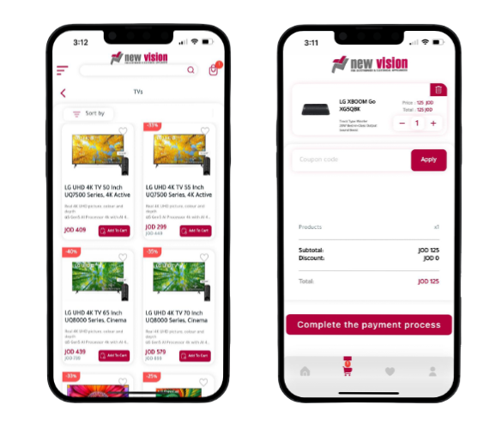
Website design and development companies specialize in creating and maintaining websites.
www.quorawebsolution.com

Slide 6
They employ a team of skilled professionals, including web designers and web developers. Web designers focus on the visual aspects of a website, such as the layout, color scheme, typography, and imagery. Web developers handle the programming and coding aspects, ensuring the website functions seamlessly and is optimized for various devices and browsers.
Website design and development companies offer a wide range of services, including:
  Website Design: Creating user-friendly and visually appealing interfaces, ensuring optimal viewing on all devices, and developing a strong brand identity through visual elements.
  Web Development: Building the visible part of the website using HTML, CSS, and JavaScript, creating the server-side logic and database systems, and designing and developing online stores for selling products or services.
www.quorawebsolution.com

Slide 7
  Digital Marketing: Optimizing websites to rank higher in search engine results, running paid advertising campaigns, and leveraging social media to reach a wider audience.
  Website Maintenance: Keeping the website up-to-date with the latest trends and technologies, protecting the website from cyber threats and vulnerabilities, and ensuring fast loading times and smooth performance.
When choosing a website design and development company, consider the following factors:
  Define Your Needs: Clearly outline your project requirements, including budget, timeline, and specific features.
  Research and Shortlist: Identify potential companies based on their portfolio, expertise, and client reviews.
www.quorawebsolution.com

Slide 8
  Communication and Collaboration: Assess how well the company communicates and collaborates with clients.
  Pricing and Contracts: Understand the pricing structure, payment terms, and contract details.
  Technical Expertise: Ensure the company has the necessary skills and experience to handle your project.
By carefully considering these factors, you can select a website design and development company that aligns with your business goals and delivers exceptional results. A well-crafted website is a powerful tool that can help you achieve your online objectives. By partnering with a reputable website design and development company, you can create a digital presence that leaves a lasting impression.
Building Your Digital Foundation: A Guide to Website Design and Development Companies
www.quorawebsolution.com

Slide 9
In today's digital age, a well-designed website is no longer a luxury but a necessity for businesses of all sizes. A professional website can significantly impact your online visibility, brand reputation, and overall business success.
Website design and development companies are experts in crafting and managing online platforms. They employ a team of skilled professionals, including web designers and web developers. Web designers are the creative minds behind a website's visual appeal. They craft the layout, choose the color scheme, select fonts, and curate the imagery to create a visually stunning and engaging experience for users. Their goal is to make the website not only beautiful but also easy to navigate and understand. Web developers handle the programming and coding aspects, ensuring the website functions seamlessly and is optimized for various devices and browsers.
www.quorawebsolution.com

Slide 10
Website design and development companies offer a wide range of services, including:
  Website Design: Creating user-friendly and visually appealing interfaces, ensuring optimal viewing on all devices, and developing a strong brand identity through visual elements.
  Web Development: Building the visible part of the website using HTML, CSS, and JavaScript, creating the server-side logic and database systems, and designing and developing online stores for selling products or services.
  Digital Marketing: Optimizing websites to rank higher in search engine results, running paid advertising campaigns, and leveraging social media to reach a wider audience.
www.quorawebsolution.com

Slide 11
  Website Maintenance: Keeping the website up-to-date with the latest trends and technologies, protecting the website from cyber threats and vulnerabilities, and ensuring fast loading times and smooth performance.
When choosing a website design and development company, consider the following factors:
  Define Your Needs: Clearly outline your project requirements, including budget, timeline, and specific features.
  Research and Shortlist: Identify potential companies based on their portfolio, expertise, and client reviews.
www.quorawebsolution.com

Slide 12
  Communication and Collaboration: Assess how well the company communicates and collaborates with clients.
  Pricing and Contracts: Understand the pricing structure, payment terms, and contract details.
  Technical Expertise: Ensure the company has the necessary skills and experience to handle your project.
By carefully considering these factors, you can select a website design and development company that aligns with your business goals and delivers exceptional results.
www.quorawebsolution.com

Slide 13
A well-crafted website is a powerful tool that can help you achieve your online objectives. By partnering with a reputable website design and development company, you can create a digital presence that leaves a lasting impression.
www.quorawebsolution.com

Slide 14
Quora Web Solution: Quora Web Solution is a trusted website development company based in Bangalore, India, offering a wide array of services to not only domestic but global clientele. Be it Website Design and Development, SEO services, Digital Marketing, Branding, App Development, Ecommerce Solution, and Logo Creation . Quora Web Solution has the best website developers offering top quality services and that is the reason why we are well known as one of the best Website Development Companies in Bangalore, India.
Visit Us - www.quorawebsolution.com
Call Us - +91 9986 056 909
Mail Us - info@quorawebsolutions.com
www.quorawebsolution.com

Slide 15

WORDPRESS DEVELOPMENT
ECOMMERCE DEVELOPMENT
PHP DEVELOPMENT
CMS DEVELOPMENT
DRUPAL DEVELOPMENT
WEBSITE SERVICES
WEBPORTAL DEVELOPMENT
MAGENTO DEVELOPMENT
WEBSITE DEVELOPMENT
JOOMLA DEVELOPMENT
SMALL BUSINESS DEVELOPMENT
CHEAP WEBSITE DEVELOPMENT
STATIC WEBSITE DEVELOPMENT
DYNAMIC WEBSITE DEVELOPMENT
WEBSITE DESIGN COMPANY
TOUR AND TRAVEL WEBSITE DEVELOPMENT
Services

