Slide 1

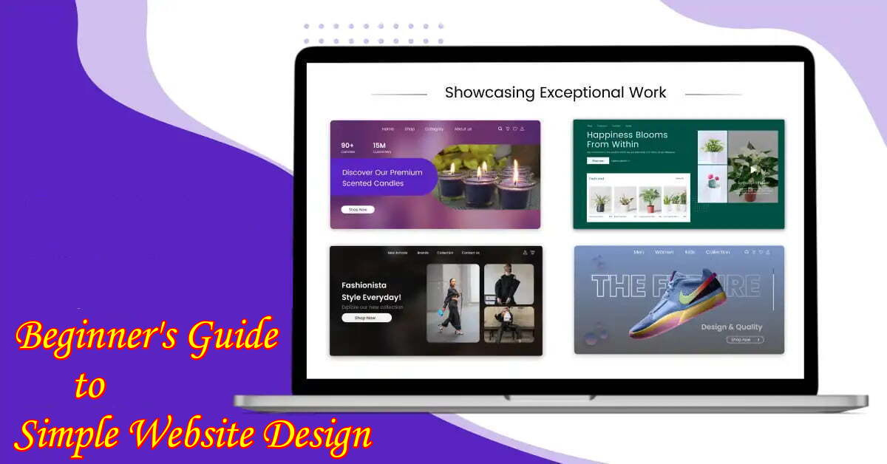
Quora Web Solution
Website Design and
Development
Company
Web Design & Web Development
Company in Bangalore, India
www.quorawebsolution.com
+91 9986 056 909
info@quorawebsolutions.com
24A, 1st Main Rd, Chandra Reddy
Layout, Koramangala 4th Block,
Koramangala, Bengaluru,
Karnataka 560034

Slide 2

The Comprehensive Guide to Website Design and Development: Best Practices, Key Trends, and Future-Proofing Your Online Presence
www.quorawebsolution.com

Slide 3

In today's digital age, your website is often the first point of interaction between your business and potential customers.
www.quorawebsolution.com

Slide 4

Whether you're launching a new website or revamping an existing one, understanding the fundamentals of website design and development is crucial for success.
www.quorawebsolution.com

Slide 5

This guide will walk you through best practices, key trends, and strategies to future-proof your online presence.
www.quorawebsolution.com

Slide 6
1. Best Practices for Website Design and Development
User-Centric Design
The user experience (UX) should be at the heart of your website's design. Make sure your website is intuitive, easy to navigate, and visually appealing. Prioritize clear calls to action (CTAs), simple navigation, and fast-loading pages. A well-designed website leads to better user engagement, longer visits, and higher conversion rates.
Responsive Design
With a majority of web traffic coming from mobile devices, responsive design is no longer optional. Your website should adapt to different screen sizes and resolutions, ensuring a seamless experience across smartphones, tablets, and desktops.
www.quorawebsolution.com

Slide 7
Google also prioritizes mobile-friendly websites in search rankings, making responsiveness vital for SEO.
Fast Loading Speed
Website speed directly affects both user experience and SEO. Slow-loading pages can cause users to bounce, leading to lost opportunities. Optimize images, reduce the use of heavy scripts, and leverage caching to improve loading times. Tools like Google PageSpeed Insights can help assess and optimize your site's performance.
SEO-Friendly Architecture
Search engine optimization (SEO) should be integrated into your website’s design from the start. Ensure that your website’s structure is optimized for search engines by using clean code, optimizing image alt text, and incorporating relevant keywords into your content.
www.quorawebsolution.com

Slide 8
A well-optimized website is more likely to rank higher on search engines, bringing in organic traffic.
2. Key Trends in Website Design and Development
Minimalist Design
Minimalism continues to be a dominant trend in web design. Clean layouts with ample white space not only make your content more readable but also enhance user focus on essential elements. A clutter-free design is both modern and effective.
Dark Mode
Dark mode has gained traction in recent years, with many users preferring it for its eye-friendly qualities and stylish appearance. Implementing a dark mode option on your website can enhance user experience and provide a contemporary feel.
AI and Automation
www.quorawebsolution.com

Slide 9
Artificial intelligence is revolutionizing website development. AI-driven features like chatbots, personalized content, and smart search are improving user interaction. Automation tools are also streamlining the development process, making it easier to integrate complex functionality without manual effort.
Voice Search Optimization
With the rise of voice-activated devices, optimizing your website for voice search is becoming increasingly important. Focus on conversational keywords and natural language to ensure your content is easily discoverable through voice queries.
3. Future-Proofing Your Website
Scalability
As your business grows, your website needs to scale with it.
www.quorawebsolution.com

Slide 10
Choose a flexible CMS (Content Management System) like WordPress, Shopify, or Drupal that allows for easy updates and expansion. Planning for scalability ensures your website remains functional and relevant as your needs evolve.
Security
Website security is a top priority. Implement SSL certificates, regular security audits, and up-to-date software to protect your site from cyber threats. A secure website builds trust with users and improves your site’s SEO rankings.
Continuous Updates and Maintenance
Web development is not a one-time task. Regular updates, security patches, and content refreshes are essential to maintaining a high-performing website.
www.quorawebsolution.com

Slide 11
Ongoing maintenance helps keep your website up-to-date with the latest trends, technologies, and security standards.
Sustainability and Accessibility
In the future, sustainability and accessibility will become even more important in website design. Websites should be built with energy-efficient hosting and optimized for users with disabilities. Ensuring that your website is accessible to everyone is not only a legal requirement in many countries but also a way to demonstrate inclusivity and build a larger audience.
Conclusion
A well-designed and developed website is more than just a digital presence; it's an essential tool for growing your business.
www.quorawebsolution.com

Slide 12
By following best practices, staying ahead of trends, and future-proofing your site, you can create an online presence that not only attracts visitors but also keeps them engaged for the long term. Whether you're starting from scratch or looking to improve an existing site, the time to invest in thoughtful design and development is now.
Mastering Website Design and Development: How to Create Visually Stunning and Highly Functional Websites for Maximum User Engagement
www.quorawebsolution.com

Slide 13
In today’s competitive digital landscape, having a website that’s both visually stunning and highly functional is crucial for engaging visitors and driving conversions. A well-designed website not only attracts visitors but keeps them interested and encourages them to take action. In this article, we’ll explore the essential elements of designing and developing a website that balances aesthetics with functionality to maximize user engagement.
1. Focus on User Experience (UX)
User experience is at the core of website success. A website that’s easy to navigate and intuitive to use will keep visitors coming back. Here’s how to achieve that:
Clear Navigation: Ensure that your website’s menu is straightforward and easily accessible. Categorize content logically so users can find what they need without frustration.
www.quorawebsolution.com

Slide 14
Responsive Design: Your site should look and function beautifully on any device, whether it’s a desktop, tablet, or mobile phone. A responsive design is a must in today’s mobile-first world.
Fast Load Times: Visitors expect quick-loading pages. Slow load times not only frustrate users but can also hurt your SEO rankings. Optimize images and reduce unnecessary scripts to speed up page load times.
2. Visual Design: Making a Strong First Impression
Your website's visual design plays a significant role in user engagement. First impressions matter, and the aesthetics of your site can either attract or repel visitors.
Consistent Branding: Use colors, fonts, and imagery that align with your brand identity. Consistent branding builds trust and helps visitors instantly recognize your business.
High-Quality Imagery: Invest in high-quality images that resonate with your audience. Avoid stock photos that feel generic. Custom photos or well-curated graphics can make your site feel more personal and engaging.
www.quorawebsolution.com

Slide 15
Whitespace: Don’t clutter your pages with too much information. Embrace whitespace to make your content easy to read and your site less overwhelming. Minimalist design is a growing trend for a reason—it works!
3. Functionality: Building a Seamless User Journey
A beautiful website is only effective if it works well. Functionality is critical in keeping users engaged and ensuring they can easily interact with your site.
Intuitive CTAs (Calls to Action): Make sure that your CTAs stand out and are easy to find. Whether it’s a “Buy Now” button, a contact form, or a newsletter signup, clear and compelling CTAs guide users toward the next step in their journey.
Interactive Elements: Adding interactive features like sliders, animations, or scroll effects can make your website more dynamic and engaging. However, be careful not to overdo it.
www.quorawebsolution.com

Slide 16
Too many flashy elements can slow down your site and detract from the user experience.
E-commerce Functionality: If you’re running an online store, a seamless shopping experience is key. Ensure your checkout process is smooth, your product pages are well-organized, and payment options are secure.
4. SEO and Content Strategy
Even the most visually stunning website won’t succeed if people can’t find it. That’s where SEO (Search Engine Optimization) comes in.
Keyword Optimization: Use relevant keywords naturally throughout your content, including titles, headings, and meta descriptions. This will help your site rank higher in search engines and attract organic traffic.
Quality Content: Provide value through your content. Whether it's blog posts, product descriptions, or landing page copy, your content should inform, engage, and meet the needs of your target audience.
www.quorawebsolution.com

Slide 17
Mobile Optimization: Google gives priority to mobile-friendly sites in search results, so make sure your website is optimized for mobile. This includes fast load times, easy navigation, and clear readability on smaller screens.
5. Regular Testing and Iteration
Creating a visually stunning and functional website doesn’t stop at launch. To ensure continuous engagement, you need to test and optimize your site regularly.
A/B Testing: Regularly test different versions of pages, headlines, CTAs, or images to see which performs better. Small tweaks can lead to big improvements in engagement and conversions.
Analytics: Use tools like Google Analytics to track user behavior on your site.
www.quorawebsolution.com

Slide 18
Look at bounce rates, page views, and average time on page to identify areas where users may be losing interest.
Feedback: Ask your visitors for feedback, either through surveys or user testing. Direct insights from real users can help you identify pain points and make necessary improvements.
6. Accessibility: A Website for Everyone
An accessible website ensures that everyone, including people with disabilities, can navigate and interact with your content.
Text Contrast: Use high contrast between text and background to improve readability, especially for those with visual impairments.
www.quorawebsolution.com

Slide 19
Alt Text for Images: Provide descriptive alt text for all images to make your site accessible to users who rely on screen readers.
Keyboard Navigation: Ensure your website can be fully navigated using a keyboard, as many users with mobility impairments rely on this method.
Conclusion
Creating a visually stunning and highly functional website requires a balance between design, usability, and performance. By focusing on user experience, optimizing for mobile, and regularly testing and refining your site, you can create an engaging online presence that keeps visitors coming back. A website that looks great and works well not only attracts more users but also builds trust and drives business success in the long run.
www.quorawebsolution.com

Slide 20
Quora Web Solution: Quora Web Solution is a trusted website development company based in Bangalore, India, offering a wide array of services to not only domestic but global clientele. Be it Website Design and Development, SEO services, Digital Marketing, Branding, App Development, Ecommerce Solution, and Logo Creation . Quora Web Solution has the best website developers offering top quality services and that is the reason why we are well known as one of the best Website Development Companies in Bangalore, India.
Visit Us - www.quorawebsolution.com
Call Us - +91 9986 056 909
Mail Us - info@quorawebsolutions.com
www.quorawebsolution.com

Slide 21

WORDPRESS DEVELOPMENT
ECOMMERCE DEVELOPMENT
PHP DEVELOPMENT
CMS DEVELOPMENT
DRUPAL DEVELOPMENT
WEBSITE SERVICES
WEBPORTAL DEVELOPMENT
MAGENTO DEVELOPMENT
WEBSITE DEVELOPMENT
JOOMLA DEVELOPMENT
SMALL BUSINESS DEVELOPMENT
CHEAP WEBSITE DEVELOPMENT
STATIC WEBSITE DEVELOPMENT
DYNAMIC WEBSITE DEVELOPMENT
WEBSITE DESIGN COMPANY
TOUR AND TRAVEL WEBSITE DEVELOPMENT
Services

