Slide 1



Quora Web Solution
Website Design and
Development
Company
Web Design & Web Development
Company in Bangalore, India
www.quorawebsolution.com
+91 9986 056 909
info@quorawebsolutions.com
24A, 1st Main Rd, Chandra Reddy
Layout, Koramangala 4th Block,
Koramangala, Bengaluru,
Karnataka 560034

Slide 2
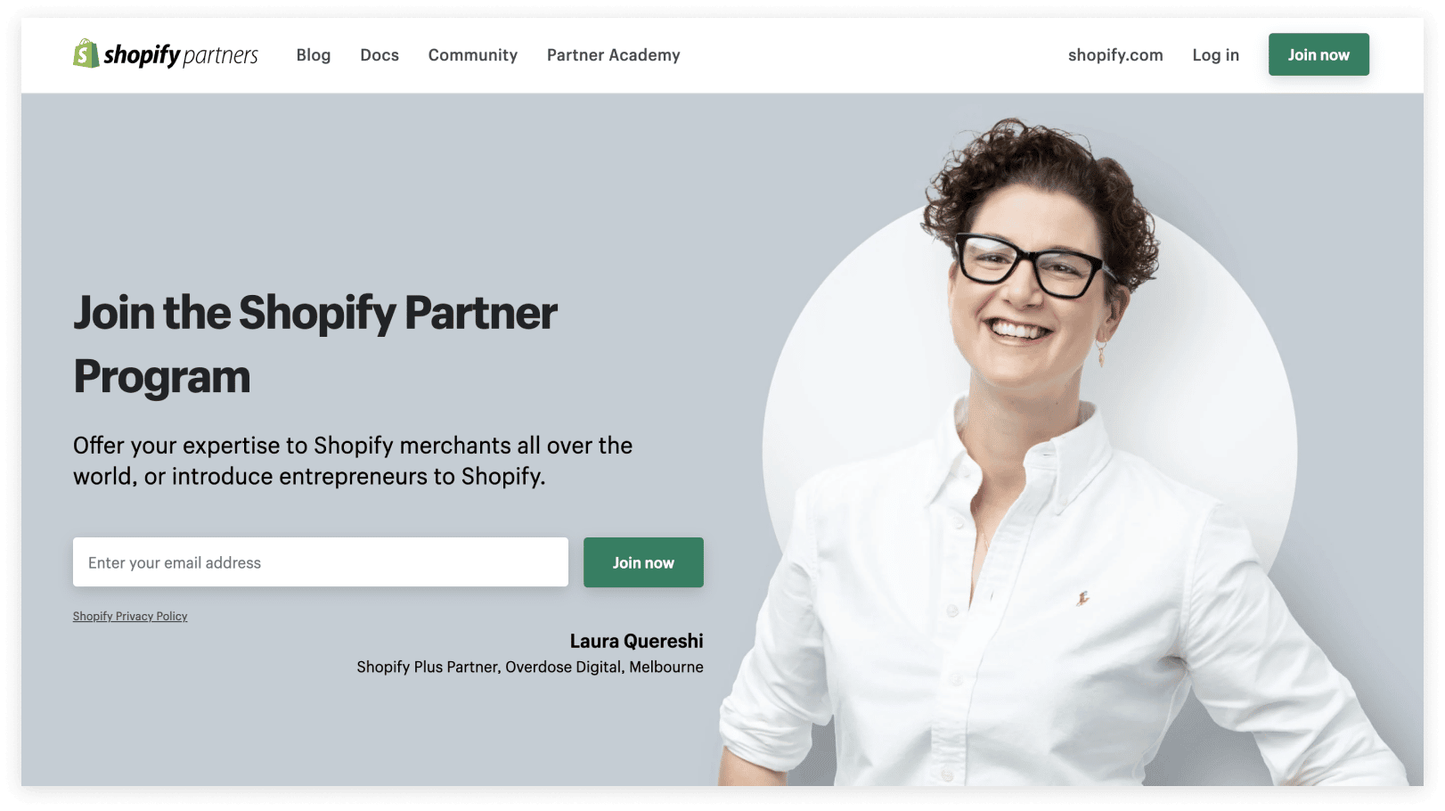
Unleash Your Online Potential: Partner with the Best Website Design and Development Companies
A strong online presence is essential for business success. A well-designed website can boost your business's success.
www.quorawebsolution.com

Slide 3

To make the most of this digital revolution, partnering with a top-notch website design and development company is crucial.
www.quorawebsolution.com

Slide 4

Why Choose a Professional Website Design and Development Company?
www.quorawebsolution.com

Slide 5

  Expertise: These companies have a team of skilled professionals who understand the nuances of web design and development. They can create visually appealing, user-friendly, and highly functional websites.
www.quorawebsolution.com

Slide 6
  Technical Knowledge: They stay updated with the latest trends and technologies, ensuring your website is optimized for search engines and mobile devices.
  Efficiency: They can deliver high-quality websites within tight deadlines, saving you valuable time and resources.
  Creativity: They can bring fresh ideas and innovative solutions to your website, setting you apart from the competition.
  Support and Maintenance: They provide ongoing support and maintenance services to keep your website running smoothly.
Key Factors to Consider:
  Portfolio: Review their past projects.
  Experience: Look for companies with a proven track record.
  Communication: Choose a company that listens to your needs.
www.quorawebsolution.com

Slide 7
  SEO Expertise: A well-optimized website can boost your online visibility.
  Responsive Design: A responsive website adapts to different screen sizes.
  Security: A secure website protects your business and customer data.
  Pricing: Get detailed quotes from multiple companies.
  Client Reviews: Positive feedback from past clients can provide valuable insights.
How to Find the Best Website Design and Development Company
  Online Research: Use search engines like Google to find reputable companies in your area or globally.
  Social Media: Explore platforms like LinkedIn to connect with professionals in the industry.
  Freelance Platforms: Websites like Upwork and Fiverr can be good options for smaller projects.
www.quorawebsolution.com

Slide 8
By carefully considering these factors and partnering with a reputable website design and development company, you can create a powerful online presence that drives growth and success.
The Digital Difference: How Top-Tier Design and Development Companies Can Transform Your Business
A strong online presence is essential for business success.To thrive in this competitive landscape, businesses must leverage the power of the internet. This is where top-tier website design and development companies come into play.
The Transformative Power of a Well-Designed Website
A well-designed website can enhance your brand image, increase online visibility, improve user experience, and boost sales and revenue.
www.quorawebsolution.com

Slide 9
Key Services Offered by Top-Tier Design and Development Companies
  Website Design: From creating stunning visuals to crafting intuitive user interfaces, these companies can design websites that are both beautiful and functional.
  Web Development: They can develop robust and scalable websites using the latest technologies, ensuring optimal performance and security.
  E-commerce Development: For businesses looking to sell products or services online, they can build feature-rich e-commerce platforms.
  Digital Marketing: They can help you implement effective digital marketing strategies, including SEO, social media marketing, and email marketing.
www.quorawebsolution.com

Slide 10
  Mobile App Development: They can create mobile apps that enhance your brand's reach and customer engagement.
How to Choose the Right Design and Development Company
When selecting a top-tier design and development company, consider the following factors:
  Portfolio: Review their past projects to assess their skills and expertise.
  Experience: Look for companies with a proven track record and a deep understanding of industry trends.
  Communication: Effective communication is key.
  Technical Expertise: Ensure they have the necessary technical skills to implement your vision.
  Client Reviews: Read reviews and testimonials from past clients to gauge their reputation.
www.quorawebsolution.com

Slide 11
  Pricing: Get quotes from multiple companies and compare their pricing models.
By partnering with a top-tier design and development company, you can unlock the full potential of your online presence and drive your business to new heights.
www.quorawebsolution.com

Slide 12
Quora Web Solution: Quora Web Solution is a trusted website development company based in Bangalore, India, offering a wide array of services to not only domestic but global clientele. Be it Website Design and Development, SEO services, Digital Marketing, Branding, App Development, Ecommerce Solution, and Logo Creation . Quora Web Solution has the best website developers offering top quality services and that is the reason why we are well known as one of the best Website Development Companies in Bangalore, India.
Visit Us - www.quorawebsolution.com
Call Us - +91 9986 056 909
Mail Us - info@quorawebsolutions.com
www.quorawebsolution.com

Slide 13




Services
WORDPRESS DEVELOPMENT
ECOMMERCE DEVELOPMENT
PHP DEVELOPMENT
CMS DEVELOPMENT
DRUPAL DEVELOPMENT
WEBSITE SERVICES
WEBPORTAL DEVELOPMENT
MAGENTO DEVELOPMENT
WEBSITE DEVELOPMENT
JOOMLA DEVELOPMENT
SMALL BUSINESS DEVELOPMENT
CHEAP WEBSITE DEVELOPMENT
STATIC WEBSITE DEVELOPMENT
DYNAMIC WEBSITE DEVELOPMENT
WEBSITE DESIGN COMPANY
TOUR AND TRAVEL WEBSITE DEVELOPMENT

