Slide 1
Aseptic Processing Equipment by MicroThermics
Aseptic Processing Equipment

Slide 2
Introduction
In the ever-evolving landscape of food and beverage production, ensuring the highest levels of safety and quality has never been more critical. This is where aseptic processing equipment becomes essential. For brands aiming to stay ahead of the curve, MicroThermics has emerged as a leader, providing innovative solutions that meet the rigorous demands of modern food production. We’ll explore the importance of aseptic processing and how MicroThermics is revolutionizing the industry with its cutting-edge equipment.

Slide 3
Understanding Aseptic Processing
Aseptic processing is a method that ensures products are free from harmful bacteria, pathogens, and other contaminants. Unlike traditional methods that may rely on preservatives or refrigeration, aseptic processing allows food and beverages to remain shelf-stable without the need for chemical additives or cold storage. This process is particularly valuable for products like dairy, soups, sauces, and fruit juices, where maintaining the original flavor, texture, and nutritional value is crucial.
The core of aseptic processing involves sterilizing both the product and the packaging separately, and then combining them in a sterile environment.

Slide 4
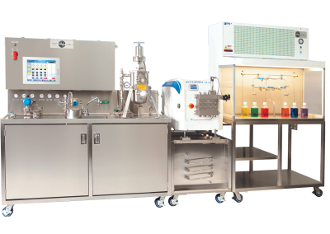
The Role of MicroThermics in Aseptic Processing
MicroThermics has positioned itself as a pioneer in the aseptic processing space, offering state-of-the-art equipment that caters to both large-scale manufacturers and small-scale producers. Their aseptic processing systems are designed with precision, efficiency, and ease of use in mind, making them a go-to choice for companies looking to improve their production processes.

Slide 5
1. Innovation and Technology
MicroThermics is renowned for integrating advanced technology into their aseptic processing equipment. Their systems are equipped with precise temperature control, ensuring that each product is processed at the optimal conditions to maintain its integrity. This level of control not only enhances the safety of the product but also preserves its quality, allowing for a superior end product that meets the highest standards.
2. Flexibility and Scalability
One of the standout features of MicroThermics’ equipment is its scalability. Whether you are a startup or a large enterprise, MicroThermics offers solutions that can be tailored to your specific needs. Their systems are designed to handle a wide range of product viscosities and volumes, making them versatile enough to accommodate various production scales.

Slide 6
Why Choose MicroThermics?
Choosing the right aseptic processing equipment is a critical decision that can have long-term implications for your business. MicroThermics stands out not only for their technological prowess but also for their commitment to customer support and training. They offer comprehensive support services, including installation, training, and ongoing technical assistance, ensuring that your team is fully equipped to operate their systems efficiently.
Furthermore, MicroThermics’ equipment is compliant with global safety and quality standards, giving you peace of mind that your products will meet regulatory requirements in any market.

Slide 7
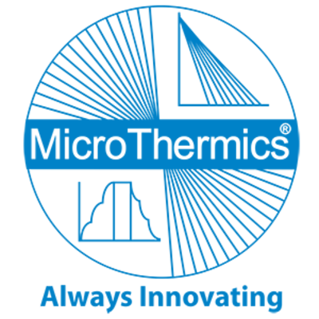
Contact Us
3216–102 Wellington Ct. Raleigh, NC 27615 USA
Phone: 9198788045
Email: info@microthermics.com
https://www.linkedin.com/company/microthermics-inc
https://www.facebook.com/microthermics
https://twitter.com/microthermics
https://microthermics.com/

