Slide 1

Ultra High Pasteurization: Revolutionizing Food Safety with MicroThermics
Ultra High Pasteurization

Slide 2
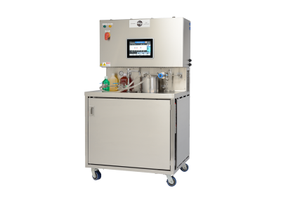
Introduction:
In the ever-evolving landscape of food technology, ensuring product safety and extending shelf life are paramount. One of the most advanced methods in achieving these goals is Ultra High Pasteurization (UHP). Among the leaders in this innovative field is MicroThermics, a brand synonymous with precision, reliability, and technological advancement.

Slide 3

What is Ultra High Pasteurization?
Ultra High Pasteurization is a process that heats products to a temperature between 280°F and 300°F (137.8°C to 148.9°C) for 2 to 4 seconds. This technique effectively eliminates harmful bacteria and pathogens while preserving the nutritional and sensory qualities of the product. Unlike traditional pasteurization, which involves lower temperatures and longer times, UHP offers a more efficient and effective way to ensure food safety and quality.

Slide 4
Why Choose Ultra High Pasteurization?
Extended Shelf Life: UHP significantly extends the shelf life of dairy and other perishable products. By eliminating nearly all spoilage microorganisms, products can remain fresh for much longer without the need for preservatives.
Nutritional Preservation: One of the key advantages of UHP is its ability to preserve the nutritional integrity of foods. Vitamins and minerals are retained more effectively compared to traditional pasteurization methods.

Slide 5
MicroThermics: The Gold Standard in UHP
MicroThermics is a pioneering brand in the field of Ultra High Pasteurization. With a reputation for cutting-edge technology and unmatched expertise, MicroThermics offers solutions that cater to the diverse needs of the food and beverage industry.
Innovations and Technology
MicroThermics equipment is designed with precision and flexibility in mind. Their UHT/HTST processors are capable of simulating both laboratory and commercial-scale pasteurization processes, making them an invaluable tool for product development and quality control.

Slide 6
Applications Across Industries
MicroThermics' UHP technology is utilized across various sectors within the food and beverage industry. Here are a few examples:
Dairy: From milk to cream and yogurt, UHP helps in producing dairy products with extended shelf life and superior safety.
Juices and Beverages: Fruit juices and other beverages benefit from UHP by maintaining their fresh taste and nutritional content while ensuring microbial safety.
Plant-Based Alternatives: As the demand for plant-based foods grows, UHP is crucial in ensuring these products meet safety standards without compromising on quality.

Slide 7
Contact Us
3216–102 Wellington Ct. Raleigh, NC 27615 USA
Phone: 9198788045
Email: info@microthermics.com
https://www.linkedin.com/company/microthermics-inc
https://www.facebook.com/microthermics
https://twitter.com/microthermics
https://microthermics.com/thermal-processes/uht-htst-processing/

