Slide 1


Quora Web Solution
Website Design and
Development
Company
Web Design & Web Development
Company in Bangalore, India
www.quorawebsolution.com
+91 9986 056 909
info@quorawebsolutions.com
24A, 1st Main Rd, Chandra Reddy
Layout, Koramangala 4th Block,
Koramangala, Bengaluru,
Karnataka 560034

Slide 2
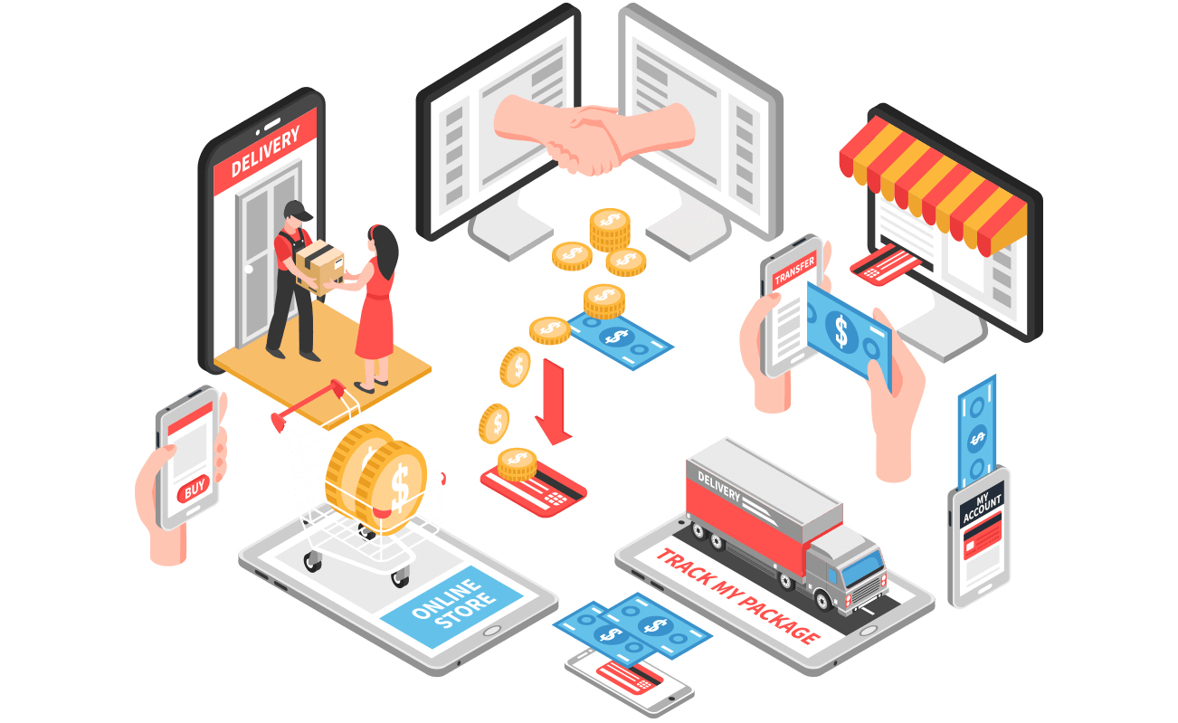
E-Commerce Website Design and Development: Key Features and Best Practices for Creating an Online Store That Maximizes Sales and Customer Retention.
www.quorawebsolution.com

Slide 3

Building a successful e-commerce website is more than just showcasing products; it’s about creating a seamless shopping experience that not only attracts customers but also keeps them coming back.
www.quorawebsolution.com

Slide 4

Here’s a guide to the key features and best practices for designing and developing an online store that maximizes sales and customer retention.
www.quorawebsolution.com

Slide 5

1. Responsive Design
A responsive website adapts to any device, whether it's a desktop, tablet, or mobile phone.
www.quorawebsolution.com

Slide 6
With mobile shopping on the rise, it’s crucial that your e-commerce site looks and functions flawlessly across all screen sizes. A mobile-friendly design improves user experience, reduces bounce rates, and increases conversions.
2. Fast Loading Speed
Website speed is a critical factor in both user experience and SEO. A delay of even a few seconds can lead to lost sales and decreased customer satisfaction. Optimize your site’s performance by compressing images, minimizing code, and using content delivery networks (CDNs) to improve page load times. Aim for a loading speed under 3 seconds for better engagement.
3. User-Friendly Navigation
www.quorawebsolution.com

Slide 7
A clean, intuitive navigation structure makes it easy for visitors to find what they’re looking for. Categorize your products logically and offer search filters to help customers refine their choices. A well-organized menu with clear product categories and a visible search bar can improve the shopping experience and encourage longer visits.
4. High-Quality Product Images & Descriptions
Product images are the closest online shoppers can get to physically interacting with your products. High-resolution, detailed images from multiple angles help customers make informed decisions. Accompanying these images with concise yet descriptive product details, including specifications and sizes, boosts consumer confidence and reduces the likelihood of returns.
5. Secure and Simple Checkout Process
www.quorawebsolution.com

Slide 8
A complicated or lengthy checkout process can cause cart abandonment. Keep the process simple and secure by offering guest checkout options, multiple payment gateways (e.g., credit cards, PayPal, etc.), and visible security badges to reassure customers. Allow users to save their shipping information for quicker future purchases.
6. Customer Reviews and Ratings
Including customer reviews and ratings on product pages builds trust and helps potential buyers make confident decisions. Positive reviews can enhance your credibility, while addressing negative feedback shows that you care about customer satisfaction. Encouraging reviews after a purchase can also boost retention.
7. Search Engine Optimization (SEO)
Optimize your e-commerce site for search engines to improve visibility.
www.quorawebsolution.com

Slide 9
Use keyword-rich titles, meta descriptions, and alt text for images. Organize your URLs logically and ensure that your content, including blog posts and product descriptions, are SEO-friendly. A well-optimized site will attract organic traffic and increase sales without relying solely on paid ads.
8. Personalized Shopping Experience
Leverage data and analytics to offer personalized product recommendations based on customer behavior, previous purchases, or browsing history. A personalized shopping experience makes customers feel valued and increases the likelihood of repeat purchases.
9. Clear Call-to-Action (CTA) Buttons
Your CTAs should be visible and compelling, encouraging users to take action—whether that’s “Add to Cart,” “Checkout,” or “Subscribe.”
www.quorawebsolution.com

Slide 10
Use contrasting colors for buttons to make them stand out, and keep your messaging clear and action-oriented.
10. Post-Purchase Engagement
The shopping experience doesn’t end after a purchase. Send order confirmations, shipping updates, and thank-you emails to enhance customer satisfaction. Offering discounts, loyalty points, or personalized recommendations for future purchases can encourage repeat business and increase customer retention.
11. Integrated Analytics and Tracking
Integrating tools like Google Analytics or custom e-commerce analytics lets you track user behavior, conversion rates, and sales performance. With this data, you can continuously refine your site and marketing strategies to optimize for higher sales and customer retention.
www.quorawebsolution.com

Slide 11
Conclusion
A successful e-commerce website design and development strategy requires a mix of aesthetics, functionality, and user-centric features. By focusing on speed, ease of navigation, security, and personalized experiences, you can create an online store that not only maximizes sales but also builds long-term customer loyalty. Keep iterating based on user feedback and analytics to stay competitive and continue driving growth
Top Trends in Website Design and Development for 2025: What Every Business Needs to Know to Stay Ahead of the Curve
www.quorawebsolution.com

Slide 12
As technology evolves, so do the expectations of website visitors. In 2025, staying ahead of the curve means adopting new trends in design and development that not only enhance user experience but also improve performance and engagement. Here are the key trends businesses need to know to keep their websites competitive and relevant in the coming year.
1. AI-Powered Design Tools
Artificial Intelligence (AI) is revolutionizing the design process. AI-powered design tools can help create personalized websites in a fraction of the time. These tools use machine learning to suggest design elements, color schemes, and layouts based on user preferences and behavior. In 2025, businesses will increasingly rely on AI to automate repetitive tasks and deliver tailored, dynamic websites that evolve with user interactions.
2. Voice Search Optimization
www.quorawebsolution.com

Slide 13
With the rise of voice-activated devices like Alexa, Siri, and Google Assistant, voice search is becoming a dominant way to interact with websites. In 2025, optimizing your website for voice search will be essential. This involves using natural language keywords, concise content, and implementing structured data (Schema) to ensure your site ranks well in voice search results, providing a seamless experience for users.
3. 3D and Immersive Experiences
The trend toward 3D elements and immersive experiences, such as Virtual Reality (VR) and Augmented Reality (AR), is growing. By 2025, more websites will incorporate these interactive elements to engage users. For businesses in industries like e-commerce, real estate, and entertainment, offering a 3D product view or an AR try-on experience can significantly enhance the user experience and increase conversions.
4. Dark Mode as Standard
www.quorawebsolution.com

Slide 14
Dark mode has moved from a trendy feature to a user preference, with many apps and websites offering the option. In 2025, dark mode will become a standard offering, with many websites automatically detecting user preferences and adjusting accordingly. This feature improves accessibility, reduces eye strain, and conserves battery life on devices, making it essential for a future-proof website.
5. Minimalist and Streamlined Design
While bold, vibrant designs will always have their place, minimalist design is becoming increasingly popular. In 2025, businesses will focus on clean, simple layouts that prioritize user experience (UX). Streamlined navigation, ample white space, and clear calls to action (CTAs) will dominate the web, making it easier for visitors to navigate and take desired actions quickly.
6. Advanced Security Features
www.quorawebsolution.com

Slide 15
As cyber threats evolve, website security becomes an even greater priority. By 2025, websites will adopt more advanced security measures, including multi-factor authentication (MFA), encrypted data storage, and even AI-powered security solutions to prevent breaches. Businesses must stay vigilant and ensure their websites are secure to maintain trust with users and comply with evolving privacy regulations.
7. 5G Technology for Faster Experiences
With 5G networks becoming more widespread, websites will be able to deliver faster, more seamless experiences. Faster internet speeds mean less lag time and more data-intensive features like high-resolution images, videos, and interactive elements can be integrated without sacrificing speed. As 5G becomes the norm, optimizing your website for faster loading times will be crucial for both user retention and SEO.
www.quorawebsolution.com

Slide 16
8. Personalized User Experiences
Personalization continues to be a hot trend. In 2025, businesses will use AI and machine learning to provide highly personalized experiences, offering recommendations based on user behavior, past purchases, and browsing history. This can take the form of tailored content, dynamic product suggestions, or region-specific information, helping businesses increase conversion rates and build stronger customer loyalty.
9. No-Code and Low-Code Development
The rise of no-code and low-code platforms is making website development more accessible. In 2025, even businesses without technical teams can design and launch professional websites using intuitive drag-and-drop builders and pre-built templates.
www.quorawebsolution.com

Slide 17
This trend is democratizing web development, enabling faster launches and empowering teams to manage and update their websites with ease.
10. Sustainability and Eco-Friendly Web Design
Sustainability isn’t just a buzzword for 2025; it’s becoming a core value for many consumers. As businesses and consumers become more eco-conscious, the demand for energy-efficient websites will grow. Optimizing websites for speed and energy consumption, such as reducing the number of server requests or using green hosting services, will be important for businesses that want to align with sustainability goals.
www.quorawebsolution.com

Slide 18
Conclusion
In 2025, website design and development will be driven by innovations in AI, personalization, security, and interactivity. To stay ahead of the curve, businesses need to adapt quickly and embrace these trends—whether it’s optimizing for voice search, creating immersive user experiences, or ensuring their websites are sustainable. By doing so, they can create websites that not only meet user expectations but also deliver exceptional experiences that drive conversions and loyalty.
www.quorawebsolution.com

Slide 19
Quora Web Solution: Quora Web Solution is a trusted website development company based in Bangalore, India, offering a wide array of services to not only domestic but global clientele. Be it Website Design and Development, SEO services, Digital Marketing, Branding, App Development, Ecommerce Solution, and Logo Creation . Quora Web Solution has the best website developers offering top quality services and that is the reason why we are well known as one of the best Website Development Companies in Bangalore, India.
Visit Us - www.quorawebsolution.com
Call Us - +91 9986 056 909
Mail Us - info@quorawebsolutions.com
www.quorawebsolution.com

Slide 20

WORDPRESS DEVELOPMENT
ECOMMERCE DEVELOPMENT
PHP DEVELOPMENT
CMS DEVELOPMENT
DRUPAL DEVELOPMENT
WEBSITE SERVICES
WEBPORTAL DEVELOPMENT
MAGENTO DEVELOPMENT
WEBSITE DEVELOPMENT
JOOMLA DEVELOPMENT
SMALL BUSINESS DEVELOPMENT
CHEAP WEBSITE DEVELOPMENT
STATIC WEBSITE DEVELOPMENT
DYNAMIC WEBSITE DEVELOPMENT
WEBSITE DESIGN COMPANY
TOUR AND TRAVEL WEBSITE DEVELOPMENT
Services

