Slide 1


Quora Web Solution
Website Design and
Development
Company
Web Design & Web Development
Company in Bangalore, India
www.quorawebsolution.com
+91 9986 056 909
info@quorawebsolutions.com
24A, 1st Main Rd, Chandra Reddy
Layout, Koramangala 4th Block,
Koramangala, Bengaluru,
Karnataka 560034

Slide 2

In today’s digital age, your website serves as the face of your business. It is often the first impression potential customers have of your brand. A well-designed website can be a game-changer, significantly impacting your online presence, credibility, customer engagement, and revenue.
www.quorawebsolution.com

Slide 3

Let’s explore how investing in high-quality website design can drive business growth.
1. Enhancing User Experience (UX)
A user-friendly website improves the overall experience for visitors, making it easier for them to navigate, find information, and complete desired actions.
www.quorawebsolution.com

Slide 4
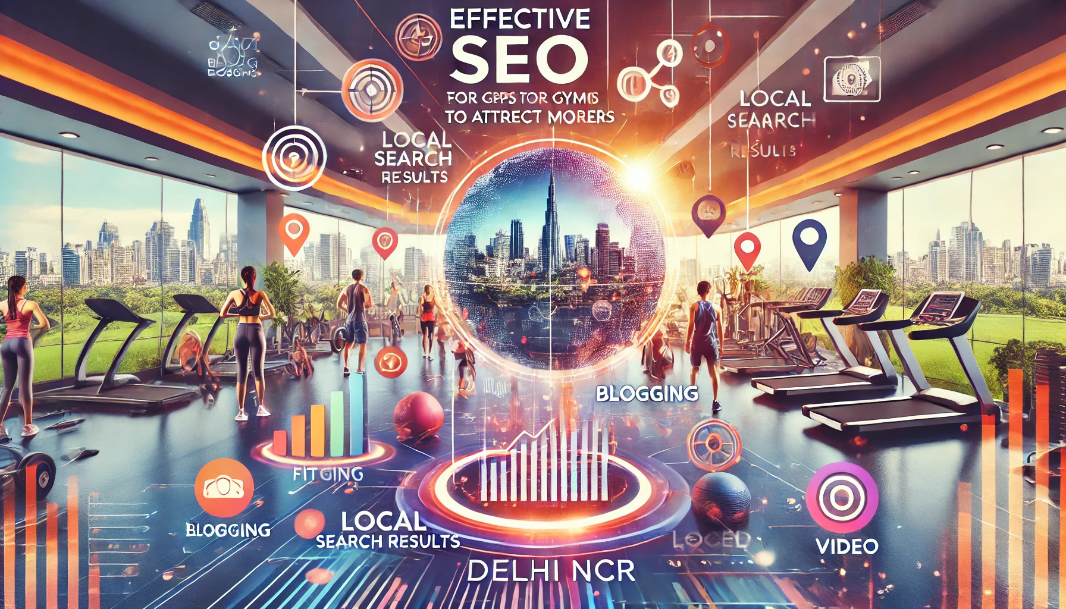
Key UX elements that contribute to a positive experience include:
Fast Loading Speed: Users expect pages to load in under three seconds.
www.quorawebsolution.com

Slide 5
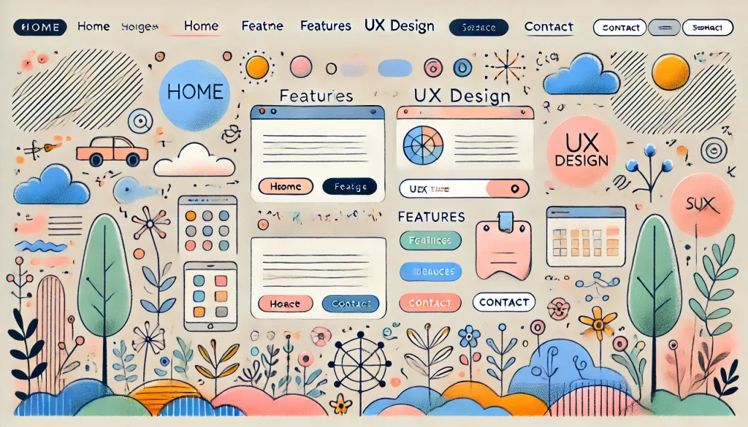
Slow websites lead to higher bounce rates.
Mobile Responsiveness: A mobile-friendly design ensures that your website is accessible on all devices, improving engagement and conversions.
www.quorawebsolution.com

Slide 6
Intuitive Navigation: Clear menus, organized content, and strategic call-to-action (CTA) buttons help users find what they need quickly.
2. Strengthening Brand Credibility and Trust
A professional and visually appealing website builds trust and credibility with visitors. Some essential design elements that enhance trust include:
Consistent Branding: Using the right color schemes, typography, and imagery that align with your brand identity.
High-Quality Content: Engaging text, compelling visuals, and well-structured information establish your authority in the industry.
Security Features: SSL certificates, secure payment gateways, and privacy policies reassure customers about their safety online.
www.quorawebsolution.com

Slide 7
3. Improving Search Engine Rankings (SEO)
Search engine optimization (SEO) is crucial for improving your website’s visibility in search results. A well-designed website contributes to SEO in the following ways:
Optimized Site Structure: Clean code, proper headings, and easy navigation make it easier for search engines to index your site.
Mobile Optimization: Google prioritizes mobile-friendly websites in search rankings.
Quality Content and Keywords: Incorporating relevant keywords naturally into high-value content improves search visibility.
Fast Page Load Times: Search engines favor websites with quick loading speeds.
4. Increasing Customer Engagement and Conversion Rates
www.quorawebsolution.com

Slide 8
A compelling design encourages users to take action, whether it’s signing up for a newsletter, making a purchase, or booking a service. Some strategies to improve engagement and conversions include:
Clear Call-to-Action (CTA): Well-placed buttons and links guide users toward the next step.
Engaging Visuals: High-quality images, videos, and graphics make content more appealing.
Personalized User Experience: AI-driven recommendations, chatbots, and tailored content enhance customer satisfaction.
5. Enhancing Social Media and Marketing Integration
A strong online presence involves more than just having a website. A well-integrated website supports your marketing efforts by:
Embedding Social Media Links: Allowing visitors to connect with your brand on different platforms.
www.quorawebsolution.com

Slide 9
Content Sharing Options: Blog posts and product pages with share buttons increase social media engagement.
Email and Lead Capture Forms: Encouraging visitors to subscribe for updates, promotions, and newsletters.
6. Maximizing Return on Investment (ROI)
A well-designed website is a cost-effective marketing tool that provides long-term benefits, including:
Lower Advertising Costs: Organic traffic from SEO reduces dependency on paid ads.
Better Customer Retention: A seamless experience encourages repeat visits and loyalty.
Increased Sales and Revenue: Higher engagement and trust lead to more conversions and profits.
www.quorawebsolution.com

Slide 10
Conclusion
A well-designed website is more than just an online presence—it’s a strategic asset that enhances user experience, strengthens brand credibility, improves search rankings, increases customer engagement, and drives revenue growth. Investing in professional web design is crucial for businesses looking to stay competitive and succeed in the digital marketplace.
Website Redesign vs. Refresh: How to Decide What’s Right for Your Business
Your website is one of your most valuable digital assets, serving as the online face of your business.
www.quorawebsolution.com

Slide 11
Over time, however, it may become outdated or fail to meet the evolving needs of your audience. When this happens, businesses often face a critical decision: should they opt for a complete website redesign or a simple refresh? Understanding the differences between the two and knowing when each is appropriate can help you make the right choice for your business.
Understanding Website Redesign vs. Refresh
What is a Website Redesign?
A website redesign is a complete overhaul of your website, including its structure, visuals, functionality, and sometimes even its content and branding. This process often involves rethinking user experience (UX), implementing new technologies, and optimizing the site for modern web standards.
Signs You Need a Website Redesign:
Your website is outdated and doesn’t align with your current branding.
www.quorawebsolution.com

Slide 12
The user experience is poor, with high bounce rates and low engagement.
Your site is not mobile-friendly or lacks responsive design.
You’re experiencing slow loading speeds and performance issues.
Your website lacks essential features and functionalities required for business growth.
Your competitors have more modern, user-friendly websites.
What is a Website Refresh?
A website refresh is a more subtle update that focuses on improving certain elements of your existing website without changing its core structure. This may include updating the design, enhancing performance, refining content, or making minor UX improvements.
Signs You Need a Website Refresh:
Your website design is generally functional but needs minor visual enhancements.
www.quorawebsolution.com

Slide 13
Your brand identity remains the same, but certain elements need updating.
Users are navigating the site well, but small UX tweaks could improve engagement.
You need to update content, images, or SEO elements without a major overhaul.
Your website has minor performance issues that can be resolved with optimizations.
Key Considerations for Choosing Between a Redesign and a Refresh
Business Goals
Consider your business objectives. If you are rebranding, expanding your services, or aiming for a complete digital transformation, a redesign may be necessary. If your goal is to improve usability, maintain relevance, and make incremental updates, a refresh may suffice.
Budget and Timeline
www.quorawebsolution.com

Slide 14
A full redesign requires more time and investment compared to a refresh. If your budget is limited, a refresh may provide meaningful improvements without extensive costs.
User Experience and Functionality
If your site is difficult to navigate, outdated, or lacking necessary features, a redesign is the best choice. If minor UX and performance optimizations can enhance engagement, a refresh can be a cost-effective solution.
Competitive Landscape
Analyze your competitors' websites. If they have modern, user-friendly sites that outperform yours, a redesign may be necessary to stay competitive.
www.quorawebsolution.com

Slide 15
Conclusion
Choosing between a website redesign and a refresh depends on your business goals, budget, and the current state of your site. If your website needs a complete transformation to align with modern standards, a redesign is the best route. However, if your site functions well but could benefit from minor enhancements, a refresh may be the right choice. By carefully evaluating your needs, you can ensure your website remains a powerful tool for driving engagement and business success.
www.quorawebsolution.com

Slide 16
Quora Web Solution: Quora Web Solution is a trusted website development company based in Bangalore, India, offering a wide array of services to not only domestic but global clientele. Be it Website Design and Development, SEO services, Digital Marketing, Branding, App Development, Ecommerce Solution, and Logo Creation . Quora Web Solution has the best website developers offering top quality services and that is the reason why we are well known as one of the best Website Development Companies in Bangalore, India.
Visit Us - www.quorawebsolution.com
Call Us - +91 9986 056 909
Mail Us - info@quorawebsolutions.com
www.quorawebsolution.com

Slide 17

WORDPRESS DEVELOPMENT
ECOMMERCE DEVELOPMENT
PHP DEVELOPMENT
CMS DEVELOPMENT
DRUPAL DEVELOPMENT
WEBSITE SERVICES
WEBPORTAL DEVELOPMENT
MAGENTO DEVELOPMENT
WEBSITE DEVELOPMENT
JOOMLA DEVELOPMENT
SMALL BUSINESS DEVELOPMENT
CHEAP WEBSITE DEVELOPMENT
STATIC WEBSITE DEVELOPMENT
DYNAMIC WEBSITE DEVELOPMENT
WEBSITE DESIGN COMPANY
TOUR AND TRAVEL WEBSITE DEVELOPMENT
Services

