Slide 1


Quora Web Solution
Website Design and
Development
Company
Web Design & Web Development
Company in Bangalore, India
www.quorawebsolution.com
+91 9986 056 909
info@quorawebsolutions.com
24A, 1st Main Rd, Chandra Reddy
Layout, Koramangala 4th Block,
Koramangala, Bengaluru,
Karnataka 560034

Slide 2
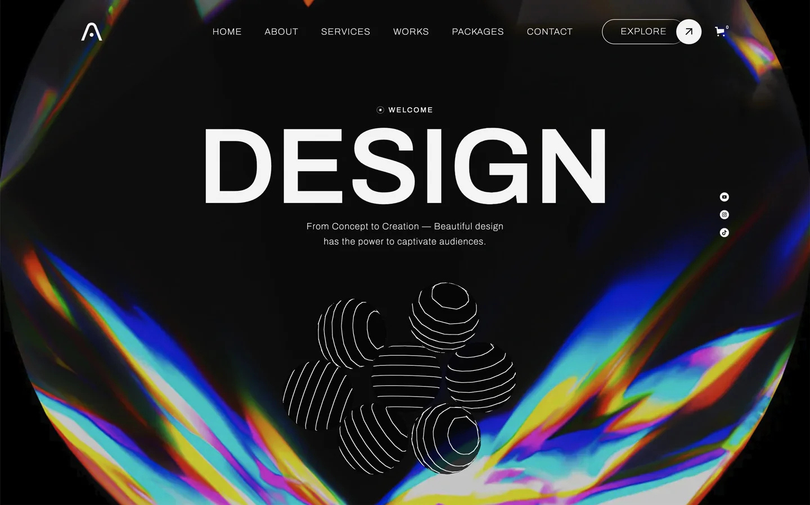
Exploring the Latest Trends in Website Design and Development: How Leading Companies are Innovating in the Digital Space
www.quorawebsolution.com

Slide 3
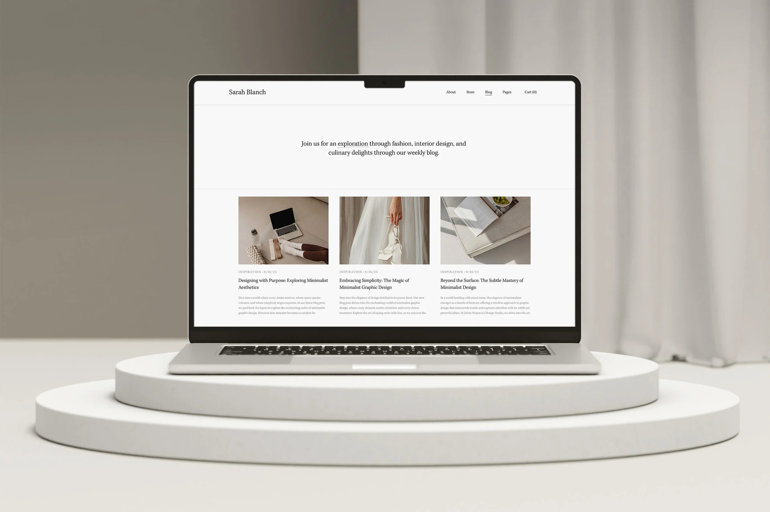
Website design and development have seen rapid advancements in recent years, driven by emerging technologies, changing user behaviors, and evolving business needs.
www.quorawebsolution.com

Slide 4

Leading companies in the field are continuously pushing boundaries to create innovative, user-centric websites.
www.quorawebsolution.com

Slide 5
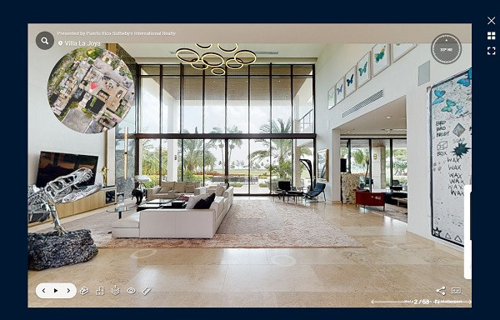
Let's explore some of the latest trends shaping the industry and how businesses are adapting to stay ahead.
www.quorawebsolution.com

Slide 6
1. Artificial Intelligence and Automation AI has become a game-changer in website design. Tools like chatbots and virtual assistants are improving user interactions and streamlining customer support. Automation is also enhancing workflows for developers, speeding up processes such as coding, testing, and maintenance. AI-driven design tools are helping designers create personalized websites by analyzing user preferences and behaviors.
2. Mobile-First Design With the rise of mobile internet usage, mobile-first design has become essential. Websites that are optimized for smartphones and tablets not only rank better on search engines but also provide a smoother experience for users. Leading companies are designing responsive websites that adapt seamlessly to various screen sizes, ensuring accessibility across devices.
3. Dark Mode Dark mode has gained immense popularity for its sleek look and reduced eye strain.
www.quorawebsolution.com

Slide 7
Many websites and apps are offering this option, allowing users to toggle between light and dark modes based on their preferences. Designers are incorporating dark mode into their websites to improve visual appeal and enhance usability in low-light conditions.
4. Micro-Interactions Micro-interactions are subtle animations or design elements that engage users without overwhelming them. Whether it's a button that changes color when hovered over or a page that smoothly transitions as you scroll, micro-interactions are elevating user experience. These small yet impactful details make websites feel more dynamic and interactive.
5. Voice Search Optimization As voice search technology becomes more widespread, optimizing websites for voice queries is becoming crucial. Leading companies are adjusting their designs to accommodate voice-based searches, making it easier for users to find what they need through spoken commands.
www.quorawebsolution.com

Slide 8
This includes optimizing content for natural language processing and structuring it to align with voice search patterns.
6. Speed and Performance Optimization Website speed is critical to both user satisfaction and SEO rankings. Companies are prioritizing performance optimization, ensuring that websites load quickly even with rich media content. Techniques such as lazy loading, image compression, and minimalistic design elements are helping reduce page load times while maintaining high-quality visuals.
7. Immersive Experiences with AR and VR Augmented reality (AR) and virtual reality (VR) are becoming increasingly popular for creating immersive, interactive experiences on websites. From virtual try-ons in fashion and beauty to 360-degree product views, these technologies are enhancing eCommerce and branding efforts, allowing users to engage with content in new and exciting ways.
www.quorawebsolution.com

Slide 9
8. Minimalist Design and Clean Layouts Minimalist design continues to dominate website aesthetics. Leading companies are focusing on simplicity, using clean layouts, plenty of white space, and a limited color palette. This approach makes websites more user-friendly and improves navigation, ensuring users can find what they need without distraction.
Conclusion The website design and development industry is evolving at a rapid pace, with leading companies embracing these innovative trends to deliver cutting-edge solutions. By leveraging AI, mobile-first design, immersive technologies, and focusing on performance optimization, businesses can create websites that not only stand out visually but also offer exceptional user experiences. As we look toward the future, these trends will continue to shape the digital space, pushing the boundaries of what's possible on the web.
How Website Design and Development Companies are Shaping the Digital Landscape: A Comprehensive Guide to Creating a Modern Online Presence
www.quorawebsolution.com

Slide 10
In today’s digital world, a strong online presence is essential for businesses to thrive. Website design and development companies are at the forefront of helping organizations create websites that are not only visually appealing but also functional, user-friendly, and optimized for performance. These companies are shaping the digital landscape by leveraging cutting-edge technologies and design trends to meet the ever-evolving needs of businesses and consumers.
1. Understanding the Importance of a Modern Website A website is often the first point of contact between a business and its customers. With consumers increasingly turning to the web to research products, services, and brands, a modern, well-designed website can make a lasting impression. A website that is user-friendly, responsive, and visually appealing can significantly boost user engagement, improve brand perception, and drive conversions.
www.quorawebsolution.com

Slide 11
2. User-Centered Design Approach Website design companies are prioritizing user experience (UX) by creating websites that are easy to navigate, visually engaging, and intuitive. A user-centered design focuses on understanding the needs and behaviors of the target audience. By conducting research and using tools like wireframes and prototypes, designers ensure that the website delivers an optimal experience, regardless of the device or platform being used.
3. Mobile-First and Responsive Design With the majority of web traffic coming from mobile devices, a mobile-first approach has become crucial. Leading website development companies are ensuring that websites are not only responsive but optimized for mobile users from the start. This includes creating flexible layouts, faster loading times, and touch-friendly features, ensuring a seamless experience across smartphones, tablets, and desktops.
www.quorawebsolution.com

Slide 12
4. SEO and Performance Optimization Search engine optimization (SEO) is integral to a website’s visibility in search engine results. Website design and development companies are incorporating SEO best practices into their designs, from creating clean code to optimizing site structure, meta tags, and content for search engines. Additionally, performance optimization, such as image compression and faster loading speeds, helps enhance both user experience and search engine rankings.
5. Content Management Systems (CMS) A Content Management System (CMS) is a vital tool for businesses that want to manage and update their website’s content easily. Leading web development companies are using platforms like WordPress, Drupal, and Joomla to empower businesses with the flexibility to make changes to their websites without needing technical expertise. A well-implemented CMS allows for dynamic content, improved scalability, and greater control over site updates.
www.quorawebsolution.com

Slide 13
6. Integrating E-Commerce Solutions As online shopping continues to rise, e-commerce websites require unique design and functionality. Website development companies are integrating e-commerce solutions such as secure payment gateways, product catalogs, and inventory management systems to provide a seamless online shopping experience. These websites are optimized for speed, security, and ease of use, ensuring that customers can make purchases effortlessly.
7. Leveraging Analytics for Continuous Improvement Website development companies are increasingly utilizing data analytics to track user behavior, monitor site performance, and identify areas for improvement. By integrating tools like Google Analytics, businesses can gain valuable insights into how visitors interact with their site, which pages are performing well, and where adjustments need to be made to improve user engagement and conversion rates.
www.quorawebsolution.com

Slide 14
8. Keeping Up with the Latest Trends To remain competitive, website design and development companies must stay ahead of design trends and technological advancements. Today, this includes incorporating features like dark mode, micro-interactions, and voice search optimization. By staying current with trends and innovations, companies ensure that their clients' websites are not only functional but also modern and ahead of the curve.
Conclusion Website design and development companies are essential partners for businesses looking to establish and grow their online presence. By focusing on user-centered design, mobile-first principles, performance optimization, and the latest technologies, these companies are creating websites that not only look great but also perform well, providing an exceptional user experience. As the digital landscape continues to evolve, the role of these companies in shaping the future of online engagement will only become more critical.
www.quorawebsolution.com

Slide 15
Quora Web Solution: Quora Web Solution is a trusted website development company based in Bangalore, India, offering a wide array of services to not only domestic but global clientele. Be it Website Design and Development, SEO services, Digital Marketing, Branding, App Development, Ecommerce Solution, and Logo Creation . Quora Web Solution has the best website developers offering top quality services and that is the reason why we are well known as one of the best Website Development Companies in Bangalore, India.
Visit Us - www.quorawebsolution.com
Call Us - +91 9986 056 909
Mail Us - info@quorawebsolutions.com
www.quorawebsolution.com

Slide 16

WORDPRESS DEVELOPMENT
ECOMMERCE DEVELOPMENT
PHP DEVELOPMENT
CMS DEVELOPMENT
DRUPAL DEVELOPMENT
WEBSITE SERVICES
WEBPORTAL DEVELOPMENT
MAGENTO DEVELOPMENT
WEBSITE DEVELOPMENT
JOOMLA DEVELOPMENT
SMALL BUSINESS DEVELOPMENT
CHEAP WEBSITE DEVELOPMENT
STATIC WEBSITE DEVELOPMENT
DYNAMIC WEBSITE DEVELOPMENT
WEBSITE DESIGN COMPANY
TOUR AND TRAVEL WEBSITE DEVELOPMENT
Services

