Slide 1

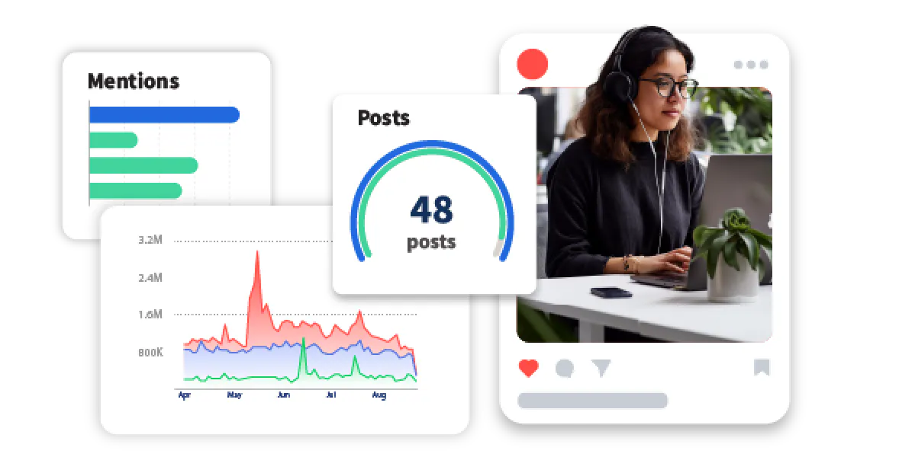

Quora Web Solution
Website Design and
Development
Company
Web Design & Web Development
Company in Bangalore, India
www.quorawebsolution.com
+91 9986 056 909
info@quorawebsolutions.com
24A, 1st Main Rd, Chandra Reddy
Layout, Koramangala 4th Block,
Koramangala, Bengaluru,
Karnataka 560034

Slide 2

Partner with a Website Design and Development Company to Elevate Your Online Presence
A website design and development company is a team of skilled professionals who specialize in crafting custom websites that meet the unique needs of businesses and individuals.
www.quorawebsolution.com

Slide 3

They work together to create visually appealing, user-friendly, and functional websites that help businesses achieve their goals.
Key Services Offered:
www.quorawebsolution.com

Slide 4

  Website Design: Crafting visually stunning websites that align with your brand's identity and resonate with your target audience.
www.quorawebsolution.com

Slide 5

  Web Development: Building robust and functional websites using cutting-edge programming languages and frameworks.
www.quorawebsolution.com

Slide 6
  E-commerce Development: Creating seamless online shopping experiences for your customers, complete with secure payment gateways and intuitive navigation.
  Content Management Systems (CMS): Implementing user-friendly CMS platforms that empower you to easily update and manage your website content.
  Search Engine Optimization (SEO): Optimizing your website to improve its visibility in search engine results, driving organic traffic and increasing your online reach.
  Responsive Design: Ensuring your website looks and functions flawlessly across all devices, from desktop computers to smartphones and tablets.
  Maintenance and Support: Providing ongoing maintenance and support services to keep your website running smoothly and up-to-date.
Why Hire a Website Design and Development Company?
www.quorawebsolution.com

Slide 7
  Expertise: Benefit from the deep knowledge and skills of experienced professionals in web design and development.
  Time Efficiency: Save valuable time and resources by outsourcing website creation and maintenance.
  Quality Assurance: Ensure a high-quality website that meets industry standards and exceeds your expectations.
  Cost-Effectiveness: Potentially save money in the long run by avoiding costly mistakes and downtime.
  Scalability: Easily adapt your website to accommodate your business growth and changing needs.
www.quorawebsolution.com

Slide 8
When selecting a website design and development company, consider the following factors:
  Portfolio: Examine their previous work to assess their design and development skills.
  Experience: Look for companies with a proven track record of success in the industry, demonstrating their ability to deliver exceptional results for their clients.
  Communication: Ensure effective communication and collaboration throughout the project.
  Pricing: Obtain clear quotes and understand their pricing structure.
  Client Testimonials: Read reviews from previous clients to gauge their satisfaction.
By partnering with a reputable website design and development company, you can unlock the full potential of your online presence. They will help you create a website that is not only visually stunning but also effective in achieving your business objectives.
www.quorawebsolution.com

Slide 9
Elevate Your Online Presence with a Website Design and Development Company
A website design and development company is a team of skilled professionals who specialize in crafting custom websites tailored to meet the unique needs of businesses and individuals. They work together to create visually appealing, user-friendly, and functional websites that help you achieve your online goals.
Key Services Offered:
  Website Design: Creating visually stunning websites that align with your brand identity and resonate with your target audience.
  Web Development: Building robust and functional websites using cutting-edge programming languages and frameworks.
www.quorawebsolution.com

Slide 10
  E-commerce Development: Designing and developing online stores that provide a seamless shopping experience for your customers.
  Content Management Systems (CMS): Implementing user-friendly CMS platforms that empower you to easily manage and update your website content.
  Search Engine Optimization (SEO): Optimizing your website to improve its visibility in search engine results, driving organic traffic and increasing your online reach.
  Responsive Design: Ensuring your website looks and functions flawlessly across all devices, from desktop computers to smartphones and tablets.
  Maintenance and Support: Providing ongoing maintenance and support services to keep your website running smoothly and up-to-date.
www.quorawebsolution.com

Slide 11
Why Choose a Website Design and Development Company?
  Expertise: Benefit from the deep knowledge and skills of our experienced web design and development team.
  Time Efficiency: Save valuable time and resources by outsourcing website creation and maintenance to our experts.
  Quality Assurance: Trust in our commitment to delivering high-quality websites that meet industry standards and exceed your expectations.
  Cost-Effectiveness: Potentially save money in the long run by avoiding costly mistakes and downtime.
www.quorawebsolution.com

Slide 12
  Scalability: Easily adapt your website to accommodate your business growth and changing needs.
When selecting a website design and development company, consider the following factors:
  Portfolio: Review their past projects to assess their design and development capabilities.
  Experience: Look for companies with a proven track record of success in the industry.
  Communication: Ensure effective communication and collaboration throughout the project.
  Pricing: Obtain clear quotes and understand their pricing structure.
www.quorawebsolution.com

Slide 13
  Client Testimonials: Read reviews from previous clients to gauge their satisfaction.
By partnering with our website design and development company, you're investing in a digital solution that will not only enhance your online presence but also drive your business forward. We'll work closely with you to create a website that's not just visually stunning but also strategically designed to achieve your goals. Together, we'll build a digital platform that reflects your brand's unique identity and propels your online success.
www.quorawebsolution.com

Slide 14
Our team of experts will leverage their skills and experience to craft a website that engages your audience, converts visitors into customers, and positions your business as a leader in your industry. We're more than just a website design and development company; we're your strategic partner in digital success. We'll help you achieve your online goals and make a lasting impression on your audience.
www.quorawebsolution.com

Slide 15
Quora Web Solution: Quora Web Solution is a trusted website development company based in Bangalore, India, offering a wide array of services to not only domestic but global clientele. Be it Website Design and Development, SEO services, Digital Marketing, Branding, App Development, Ecommerce Solution, and Logo Creation . Quora Web Solution has the best website developers offering top quality services and that is the reason why we are well known as one of the best Website Development Companies in Bangalore, India.
Visit Us - www.quorawebsolution.com
Call Us - +91 9986 056 909
Mail Us - info@quorawebsolutions.com
www.quorawebsolution.com

Slide 16




Services
WORDPRESS DEVELOPMENT
ECOMMERCE DEVELOPMENT
PHP DEVELOPMENT
CMS DEVELOPMENT
DRUPAL DEVELOPMENT
WEBSITE SERVICES
WEBPORTAL DEVELOPMENT
MAGENTO DEVELOPMENT
WEBSITE DEVELOPMENT
JOOMLA DEVELOPMENT
SMALL BUSINESS DEVELOPMENT
CHEAP WEBSITE DEVELOPMENT
STATIC WEBSITE DEVELOPMENT
DYNAMIC WEBSITE DEVELOPMENT
WEBSITE DESIGN COMPANY
TOUR AND TRAVEL WEBSITE DEVELOPMENT

