Slide 1


Quora Web Solution
Website Design and
Development
Company
Web Design & Web Development
Company in Bangalore, India
www.quorawebsolution.com
+91 9986 056 909
info@quorawebsolutions.com
24A, 1st Main Rd, Chandra Reddy
Layout, Koramangala 4th Block,
Koramangala, Bengaluru,
Karnataka 560034

Slide 2

Web Development Tools and Technologies You Should Know in 2025: A Comprehensive Guide for Building Modern Websites
www.quorawebsolution.com

Slide 3

The world of web development is constantly evolving, with new tools, frameworks, and technologies emerging every year. As we step into 2025, it's essential for developers to stay updated on the latest trends and technologies for building modern, responsive, and efficient websites.
www.quorawebsolution.com

Slide 4

Here's a comprehensive guide to the tools and technologies that should be on your radar.
1. Frontend Development
React 19 and Next.js 15
www.quorawebsolution.com

Slide 5
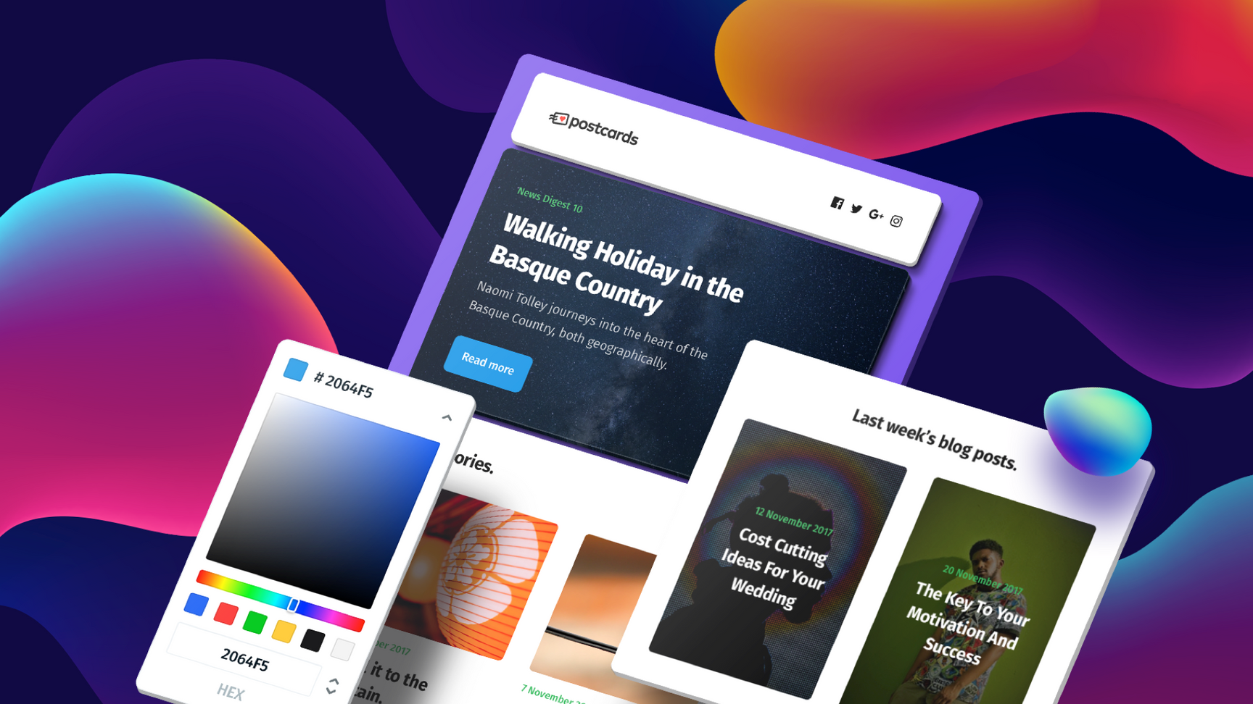
React continues to dominate frontend development, and with the release of React 19, new features like automatic server-side rendering, concurrent rendering, and better integration with TypeScript will streamline building dynamic UIs.
www.quorawebsolution.com

Slide 6
Next.js, the most popular React framework, is evolving rapidly with enhanced performance optimizations, better SEO support, and static site generation (SSG) improvements.
Tailwind CSS
Tailwind CSS has become a go-to utility-first CSS framework for building responsive designs quickly. With its recent updates, Tailwind allows developers to create complex layouts with minimal custom CSS, making it easier to implement modern, mobile-first designs.
SvelteKit
Svelte and its new version, SvelteKit, are gaining traction for their lightweight, no-virtual-DOM approach to building fast, reactive user interfaces.
www.quorawebsolution.com

Slide 7
SvelteKit offers server-side rendering (SSR) and file-based routing, making it a solid choice for developers who need both speed and simplicity.
2. Backend Development
Node.js with Deno
Node.js continues to be a mainstay for backend development, but Deno, a new JavaScript/TypeScript runtime, is challenging Node.js with its security-first approach and built-in TypeScript support. Developers are now exploring Deno for server-side applications, especially those requiring more robust security and modern features.
GraphQL
GraphQL, an alternative to REST APIs, has seen widespread adoption for querying APIs more efficiently.
www.quorawebsolution.com

Slide 8
It allows clients to request only the data they need, making it a great choice for complex applications with large data requirements. Tools like Apollo Client and Relay make integrating GraphQL easier.
Serverless Architectures
Serverless computing continues to grow in popularity. Platforms like AWS Lambda, Vercel, and Netlify Functions allow developers to run backend code without managing servers. This reduces the complexity of scaling and maintaining backend infrastructure.
3. DevOps and Deployment Tools
Docker and Kubernetes
Containerization and orchestration are essential for managing complex web applications.
www.quorawebsolution.com

Slide 9
Docker simplifies the process of packaging applications, while Kubernetes helps with orchestration, scaling, and managing containers across multiple servers.
CI/CD Pipelines
Continuous Integration (CI) and Continuous Deployment (CD) are crucial for fast and reliable delivery of web applications. Tools like GitHub Actions, GitLab CI, and CircleCI streamline the testing, building, and deployment process, enabling developers to release features faster and with fewer bugs.
Cloud Platforms
Cloud platforms like AWS, Azure, and Google Cloud provide scalable infrastructure for hosting and running web applications. In 2025, edge computing and distributed cloud services are becoming more common, improving speed and reducing latency by hosting content closer to the user.
4. Web Performance Optimization
www.quorawebsolution.com

Slide 10
Web Vitals
Google's Web Vitals have become the benchmark for web performance. Tools like Lighthouse and Core Web Vitals track metrics like loading speed, interactivity, and visual stability to ensure websites deliver optimal user experiences.
Image Optimization Tools
Optimizing images is crucial for faster page loads. Tools like ImageOptim, Cloudinary, and TinyPNG automatically compress and serve images in the best formats (like WebP) to ensure quick load times without sacrificing quality.
5. SEO and Analytics Tools
Core Web Vitals
www.quorawebsolution.com

Slide 11
As search engines increasingly prioritize performance, understanding and optimizing for Core Web Vitals will be key in improving search rankings. Google’s tools, like PageSpeed Insights and Search Console, provide actionable insights into performance and SEO improvements.
Google Analytics 4 (GA4)
Google Analytics 4 introduces an event-driven data model, offering more flexibility and in-depth analysis of user interactions across multiple platforms. Developers should familiarize themselves with GA4 to track and analyze user data more effectively.
6. Security Tools
OWASP ZAP
OWASP's ZAP (Zed Attack Proxy) is a powerful tool for identifying security vulnerabilities in web applications.
www.quorawebsolution.com

Slide 12
As security becomes even more critical in 2025, integrating ZAP into your CI/CD pipeline can help ensure your site is secure from the start.
Content Security Policy (CSP)
A Content Security Policy (CSP) is essential to mitigate cross-site scripting (XSS) attacks. Tools like Helmet.js for Express.js or CSP Header for Nginx help developers implement CSP headers to secure their applications.
Conclusion
As web development advances, staying up-to-date with the latest tools and technologies is crucial for building modern, efficient, and scalable websites. Whether you're focusing on frontend frameworks like React and Svelte, backend technologies like Node.js and GraphQL, or optimizing for performance and security, there are numerous powerful tools at your disposal in 2025.
www.quorawebsolution.com

Slide 13
By adopting the right technologies and keeping an eye on emerging trends, developers can ensure they're building the best possible web experiences for their users.
How to Choose the Right Website Design and Development Company for Your Business: A Comprehensive Guide
Choosing the right website design and development company is a critical decision for any business. Your website is often the first interaction customers have with your brand, so it’s essential to work with a team that understands your needs and can bring your vision to life. Here’s a comprehensive guide to help you select the perfect partner for your online presence.
www.quorawebsolution.com

Slide 14
1. Understand Your Needs
Before you start looking for a design and development company, take time to assess your needs. Are you looking for a simple brochure site, an e-commerce platform, or a complex, feature-rich web application? Understanding the scope of your project will help you find a company that specializes in your required services.
2. Look for Experience and Expertise
Experience matters. Search for companies that have a proven track record in designing and developing websites similar to what you need. Check their portfolio to see if they’ve worked with businesses in your industry and if their work aligns with your vision. Ask about their team’s expertise in specific areas like responsive design, SEO, user experience (UX), and back-end development.
3. Check Client Reviews and Testimonials
www.quorawebsolution.com

Slide 15
Client reviews and testimonials provide valuable insights into the quality of a company’s work and customer service. Look for reviews on independent platforms like Google, Clutch, or Trustpilot, and pay attention to both the positive feedback and any negative comments. Ask the company for case studies or references from past clients to get a better sense of how they handle projects.
4. Evaluate Their Design Process
A well-structured design process is a good sign of a company’s professionalism. The best web design and development companies follow a structured approach that includes:
Discovery phase: Understanding your business goals, audience, and brand.
Wireframing and prototyping: Creating the layout and basic structure.
Design phase: Developing the visual style, including color schemes and typography.
Development phase: Building the actual website with coding and testing.
Make sure the company’s process aligns with your expectations and that they involve you at key stages.
www.quorawebsolution.com

Slide 16
5. Ensure They Prioritize User Experience (UX)
A website that is difficult to navigate or confusing will drive visitors away. Ensure the company values user experience (UX) design and can demonstrate a solid understanding of how to make websites intuitive and user-friendly. Look for companies that conduct user research and usability testing.
6. Consider Their Communication and Collaboration Style
Good communication is key to a successful partnership. The company you choose should be easy to reach, responsive, and transparent throughout the project. Ask about their preferred communication channels and how often they provide project updates. A good web development team will also listen to your feedback and be flexible in making changes when needed.
7. Check for SEO and Mobile Optimization Expertise
Your website’s design and development should incorporate search engine optimization (SEO) best practices and be fully optimized for mobile devices.
www.quorawebsolution.com

Slide 17
Check if the company has experience with SEO fundamentals like clean code, fast loading times, proper HTML tags, and mobile-friendly designs. In 2025, mobile-first design is critical for ranking well on search engines.
8. Assess Their Support and Maintenance Services
A great website doesn’t stop once it’s live. Ensure the company offers ongoing support and maintenance services, such as bug fixes, software updates, and security patches. Ask about the post-launch support package and how they handle any potential issues that arise after the website is live.
9. Review Their Pricing Model
Pricing can vary significantly depending on the company, the complexity of your project, and the features you require. Be sure to ask for a detailed proposal that breaks down the cost, including design, development, testing, and ongoing maintenance. While you don’t want to choose solely based on price, make sure you’re getting value for your investment.
www.quorawebsolution.com

Slide 18
10. Trust Your Instincts
Finally, trust your instincts. A website design and development company should not only have the technical skills you need but also align with your company’s values and culture. Choose a team that you feel comfortable with, and who understands your business goals and vision.
Conclusion
Choosing the right website design and development company is a significant decision that impacts your online success. By following these guidelines—understanding your needs, evaluating experience and expertise, considering communication styles, and ensuring they prioritize UX—you can make a confident choice. Partnering with the right team will ensure your website not only looks great but also functions effectively to drive growth and success for your business.
www.quorawebsolution.com

Slide 19
Quora Web Solution: Quora Web Solution is a trusted website development company based in Bangalore, India, offering a wide array of services to not only domestic but global clientele. Be it Website Design and Development, SEO services, Digital Marketing, Branding, App Development, Ecommerce Solution, and Logo Creation . Quora Web Solution has the best website developers offering top quality services and that is the reason why we are well known as one of the best Website Development Companies in Bangalore, India.
Visit Us - www.quorawebsolution.com
Call Us - +91 9986 056 909
Mail Us - info@quorawebsolutions.com
www.quorawebsolution.com

Slide 20

WORDPRESS DEVELOPMENT
ECOMMERCE DEVELOPMENT
PHP DEVELOPMENT
CMS DEVELOPMENT
DRUPAL DEVELOPMENT
WEBSITE SERVICES
WEBPORTAL DEVELOPMENT
MAGENTO DEVELOPMENT
WEBSITE DEVELOPMENT
JOOMLA DEVELOPMENT
SMALL BUSINESS DEVELOPMENT
CHEAP WEBSITE DEVELOPMENT
STATIC WEBSITE DEVELOPMENT
DYNAMIC WEBSITE DEVELOPMENT
WEBSITE DESIGN COMPANY
TOUR AND TRAVEL WEBSITE DEVELOPMENT
Services

