Slide 1
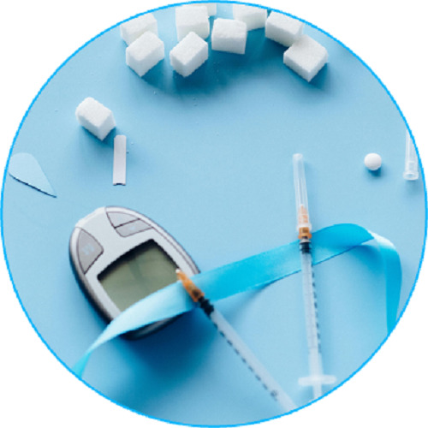
Weight Loss Medication
Upgrade your lifestyle with weight loss medication, which is designed to help you shed extra pounds safely & effectively. Start your weight loss journey today!

Slide 2

Boosters Weight Loss
Transform your weight loss journey with boosters weight loss, which are designed to enhance metabolism and promote fat burning for faster, effective results.

Slide 3
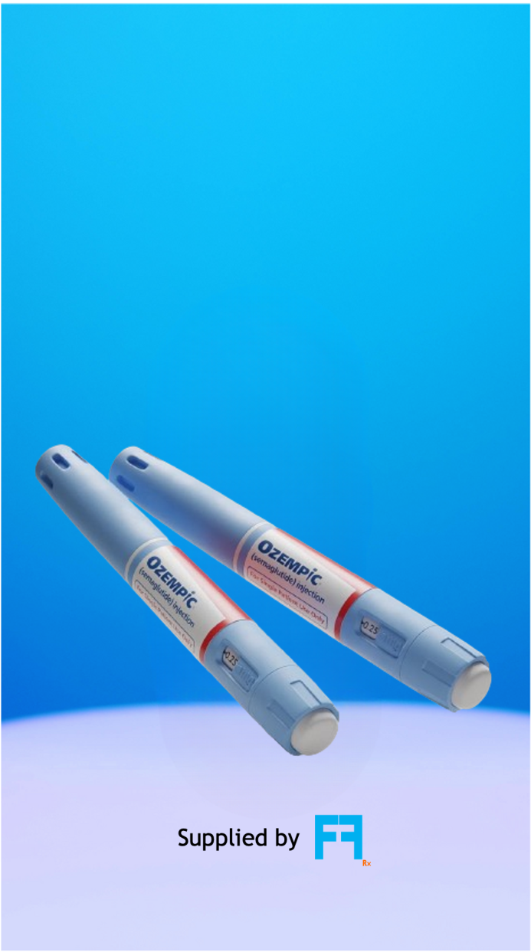
Ozempic
Want to manage weight and sugar levels effortlessly? Ozempic offers a trusted solution to help you achieve your goals with ease. Take the first step today!

Slide 4


Contact Us
About: FitFlow Rx offers personalized weight management through telehealth consultations and doorstep medication delivery. Achieve your health goals with ease and balance.
Address : 75 Henry St Brooklyn, New York 11201 United States
Website : https://www.fitflowrx.com/

