Slide 1



Quora Web Solution
Website Design and
Development
Company
Web Design & Web Development
Company in Bangalore, India
www.quorawebsolution.com
+91 9986 056 909
info@quorawebsolutions.com
24A, 1st Main Rd, Chandra Reddy
Layout, Koramangala 4th Block,
Koramangala, Bengaluru,
Karnataka 560034

Slide 2
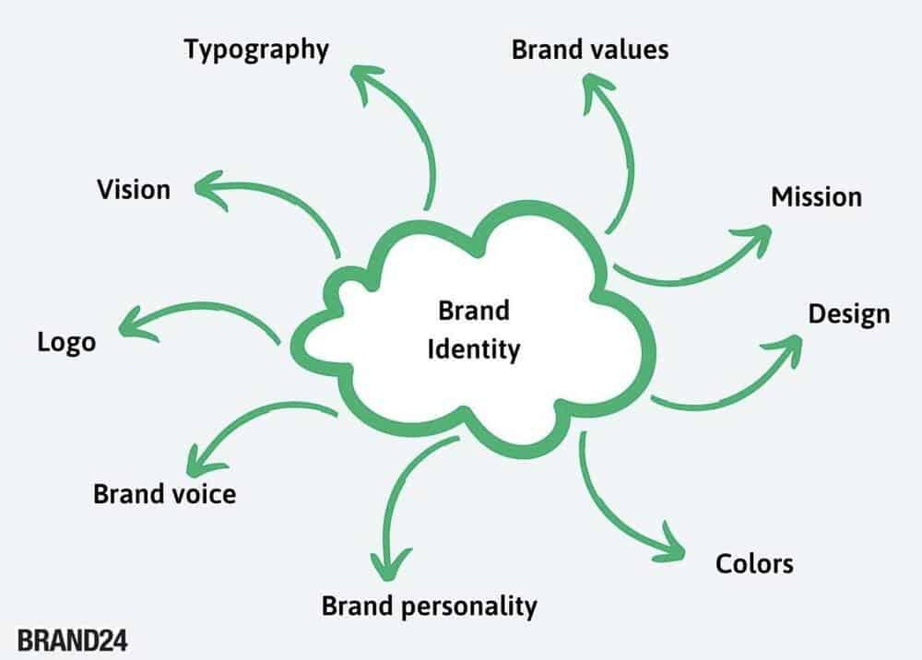
A strong online presence is essential in today's digital world. Your website is your brand's digital storefront.
www.quorawebsolution.com

Slide 3

That's why it's crucial to have a website that not only looks stunning but also performs seamlessly.
www.quorawebsolution.com

Slide 4

The Art of Web Design
www.quorawebsolution.com

Slide 5

At Website Design and Development Company, we believe that web design is more than just aesthetics.
www.quorawebsolution.com

Slide 6
It's about creating a visually appealing and user-friendly experience that resonates with your target audience. Our team of skilled designers is passionate about crafting unique and innovative designs that reflect your brand's identity.
Key Elements of Effective Web Design
  User Experience (UX): We prioritize creating intuitive and engaging user experiences. Our designs are optimized for easy navigation and seamless interaction.
  Responsive Design: Your website should look great on any device, from desktops to smartphones. Our responsive designs ensure a consistent experience across all platforms.
  Visual Appeal: We combine stunning visuals with strategic typography to create visually striking designs that capture attention.
  Brand Consistency: We work closely with you to ensure that your website aligns with your brand's overall look and feel.
The Science of Web Development
While design is the art, development is the science. Our team of experienced developers brings technical expertise to the table, ensuring that your website is not only beautiful but also functional.
www.quorawebsolution.com

Slide 7
Key Elements of Effective Web Development
  Performance Optimization: We optimize your website for speed and performance, ensuring fast loading times and smooth user experiences.
  Security: Your website's security is paramount. We protect your data and your visitors' privacy.
  SEO: We build websites with SEO in mind, helping you rank higher in search engine results and attract more organic traffic.
  Accessibility: We design and develop websites that are accessible to everyone, including individuals with disabilities.
Partner with Us
At Website Design and Development Company, we're committed to delivering exceptional web design and development services. We're more than just a service provider; we're your partner in digital success.
www.quorawebsolution.com

Slide 8
Contact us today to discuss your project and let us help you create a website that truly represents your brand.
By combining creativity and technical expertise, we'll transform your online presence and help you achieve your business goals.
Weaving the Web of Success: Your Digital Transformation Partner
Embracing the Digital Age
You need a strong online presence to succeed. At Website Design and Development Company, we're your trusted partner in navigating this complex digital world.
Our Expertise, Your Advantage
www.quorawebsolution.com

Slide 9
We create bespoke digital solutions that empower businesses to reach new heights. Our team of skilled designers, developers, and digital strategists is dedicated to delivering exceptional results.
Our Services
  Web Design and Development: From sleek, modern websites to robust e-commerce platforms, we create visually stunning and highly functional digital experiences.
  Digital Marketing: Our comprehensive digital marketing services help you attract, engage, and convert your target audience.
  Search Engine Optimization (SEO): We make your website more visible in search engine results, driving organic traffic.
  Pay-Per-Click (PPC) Advertising: We leverage the power of PPC advertising to generate immediate results and maximize your return on investment.
www.quorawebsolution.com

Slide 10
  Social Media Marketing: We create engaging social media campaigns to build brand awareness and foster community.
  Content Marketing: We develop high-quality content to educate, inform, and inspire your audience.
Why Choose Us?
  Tailored Solutions: We customize our services to fit your specific needs.
  Data-Driven Approach: We use data-driven insights to inform our strategies and measure success.
  **We use the latest technologies and trends.
  Collaborative Partnerships: We work closely with our clients to build strong, long-lasting relationships.
  Results-Oriented Focus: We're committed to delivering measurable results that drive business growth.
Ready to Elevate Your Online Presence?
Contact us today to discuss your goals. Let's collaborate and weave the web of success for your business.
www.quorawebsolution.com

Slide 11
Quora Web Solution: Quora Web Solution is a trusted website development company based in Bangalore, India, offering a wide array of services to not only domestic but global clientele. Be it Website Design and Development, SEO services, Digital Marketing, Branding, App Development, Ecommerce Solution, and Logo Creation . Quora Web Solution has the best website developers offering top quality services and that is the reason why we are well known as one of the best Website Development Companies in Bangalore, India.
Visit Us - www.quorawebsolution.com
Call Us - +91 9986 056 909
Mail Us - info@quorawebsolutions.com
www.quorawebsolution.com

Slide 12




Services
WORDPRESS DEVELOPMENT
ECOMMERCE DEVELOPMENT
PHP DEVELOPMENT
CMS DEVELOPMENT
DRUPAL DEVELOPMENT
WEBSITE SERVICES
WEBPORTAL DEVELOPMENT
MAGENTO DEVELOPMENT
WEBSITE DEVELOPMENT
JOOMLA DEVELOPMENT
SMALL BUSINESS DEVELOPMENT
CHEAP WEBSITE DEVELOPMENT
STATIC WEBSITE DEVELOPMENT
DYNAMIC WEBSITE DEVELOPMENT
WEBSITE DESIGN COMPANY
TOUR AND TRAVEL WEBSITE DEVELOPMENT

