Slide 1



Quora Web Solution
Website Design and
Development
Company
Web Design & Web Development
Company in Bangalore, India
www.quorawebsolution.com
+91 9986 056 909
info@quorawebsolutions.com
24A, 1st Main Rd, Chandra Reddy
Layout, Koramangala 4th Block,
Koramangala, Bengaluru,
Karnataka 560034

Slide 2

From Clicks to Conversions: How These Companies Deliver Results
www.quorawebsolution.com

Slide 3

Today, a strong online presence is essential. With millions of websites vying for attention, it's crucial to have a website that not only looks good but also converts visitors into customers.
www.quorawebsolution.com

Slide 4
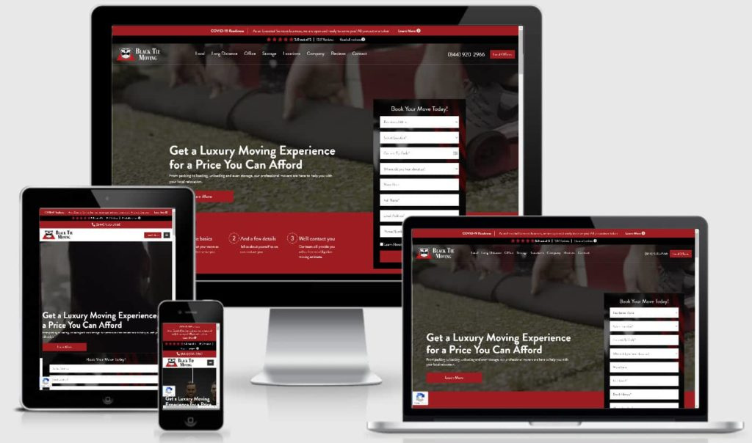
This is where top-tier website design and development companies come into play.
It's a strategic tool for business goals. A visually appealing and user-friendly website can:
www.quorawebsolution.com

Slide 5

  Enhance Brand Image: A professional website reflects positively on your brand.
  Improve User Experience: Better UX leads to higher engagement.
  Boost SEO Rankings: Optimized websites rank higher in search engine results.
www.quorawebsolution.com

Slide 6
  Increase Conversions: A well-crafted website can drive more sales and leads.
Key factors to consider when choosing a company: expertise, portfolio, testimonials, technical skills, communication, pricing, and SEO expertise.
When selecting a company to build your website, consider these key factors:
  Proven track record and industry expertise.
www.quorawebsolution.com

Slide 7
  Portfolio: Review their past projects to assess their design and development capabilities.
  Client Testimonials: Positive feedback from previous clients is a strong indicator of quality.
  Technical Skills: Ensure they have a solid understanding of the latest web technologies.
  Communication Skills: Effective communication is vital for a successful project.
  Prioritize quality over price.
  SEO Expertise: A good website design company should have a strong understanding of SEO.
Top Website Design and Development Companies
Here are some of the top-rated companies that can help you achieve your digital goals:
  Company A: Known for their innovative designs and cutting-edge technologies.
  Company B: Specializes in creating user-centric websites that drive conversions.
www.quorawebsolution.com

Slide 8
  Company C: Offers a wide range of services, from web design to e-commerce development.
  Company D: Focuses on providing affordable and high-quality web solutions.
  Company E: Experts in creating responsive websites that look great on all devices.
Conclusion
By partnering with a reputable website design and development company, you can create a digital presence that drives results. Well-designed websites are investments that pay dividends.
Revolutionizing the Web: The Power of Expert Website Design and Development
www.quorawebsolution.com

Slide 9
In today's digital age, a strong online presence is no longer a luxury; it's a necessity. With millions of websites vying for attention, it's crucial to have a website that not only looks good but also delivers results. This is where expert website design and development companies come into play.
Web design and development combines art and science.
A well-designed website is more than just a collection of pages; it's a strategic tool that can help businesses achieve their goals. By combining artistry with technical expertise, skilled web designers and developers can create stunning, user-friendly, and highly effective websites.
Key Components of a Successful Website
www.quorawebsolution.com

Slide 10
User Experience (UX): A seamless UX is crucial. Websites should be easy to navigate, visually appealing, and fast-loading.
  Search Engine Optimization (SEO): A website that's optimized for search engines will attract more organic traffic.
  Responsive Design: Ensuring your website looks great and functions flawlessly on all devices is crucial.
  Content Marketing: High-quality content attracts and engages your target audience.
  Conversion Rate Optimization (CRO): By optimizing your website for conversions, you can increase sales and leads.
The Benefits of Hiring a Professional Website Design and Development Company
www.quorawebsolution.com

Slide 11
  Expertise: Professional web designers and developers have the skills and knowledge to create top-notch websites.
  Efficiency: They can deliver projects on time and within budget.
  Creativity: They can bring fresh ideas and innovative solutions to the table.
  Technical Support: They can provide ongoing maintenance and support.
Choosing the Right Website Design and Development Company
When selecting a company, consider the following factors:
  Portfolio: Review their past projects to assess their design and development capabilities.
www.quorawebsolution.com

Slide 12
  Client Testimonials: Positive feedback from previous clients is a strong indicator of quality.
  Technical Skills: Ensure they have a solid understanding of the latest web technologies.
  Communication Skills: Effective communication is vital for a successful project. Prioritize quality over price.
Conclusion
Partner with a reputable company to unlock your online potential. A well-crafted website can help you attract more customers, generate more leads, and boost your bottom line.
www.quorawebsolution.com

Slide 13
Quora Web Solution: Quora Web Solution is a trusted website development company based in Bangalore, India, offering a wide array of services to not only domestic but global clientele. Be it Website Design and Development, SEO services, Digital Marketing, Branding, App Development, Ecommerce Solution, and Logo Creation . Quora Web Solution has the best website developers offering top quality services and that is the reason why we are well known as one of the best Website Development Companies in Bangalore, India.
Visit Us - www.quorawebsolution.com
Call Us - +91 9986 056 909
Mail Us - info@quorawebsolutions.com
www.quorawebsolution.com

Slide 14




Services
WORDPRESS DEVELOPMENT
ECOMMERCE DEVELOPMENT
PHP DEVELOPMENT
CMS DEVELOPMENT
DRUPAL DEVELOPMENT
WEBSITE SERVICES
WEBPORTAL DEVELOPMENT
MAGENTO DEVELOPMENT
WEBSITE DEVELOPMENT
JOOMLA DEVELOPMENT
SMALL BUSINESS DEVELOPMENT
CHEAP WEBSITE DEVELOPMENT
STATIC WEBSITE DEVELOPMENT
DYNAMIC WEBSITE DEVELOPMENT
WEBSITE DESIGN COMPANY
TOUR AND TRAVEL WEBSITE DEVELOPMENT

