Slide 1


Quora Web Solution
Website Design and
Development
Company
Web Design & Web Development
Company in Bangalore, India
www.quorawebsolution.com
+91 9986 056 909
info@quorawebsolutions.com
24A, 1st Main Rd, Chandra Reddy
Layout, Koramangala 4th Block,
Koramangala, Bengaluru,
Karnataka 560034

Slide 2
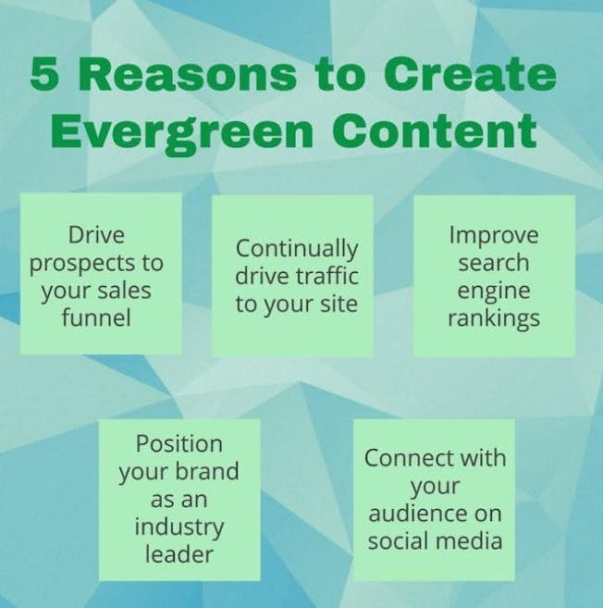
How to Leverage SEO Best Practices in Website Development for Enhanced Visibility and Traffic
www.quorawebsolution.com

Slide 3

In today's digital landscape, building a visually appealing website is just the beginning.
www.quorawebsolution.com

Slide 4
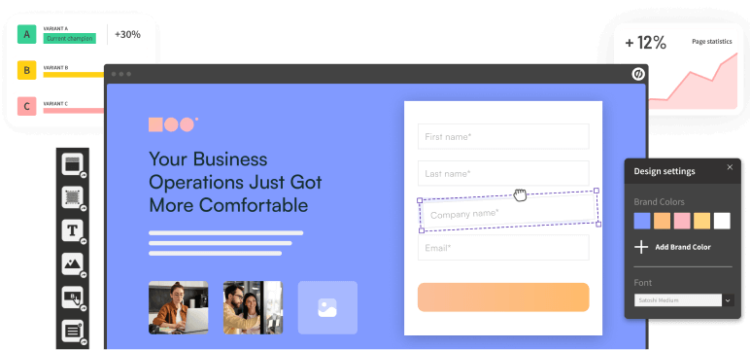
If you want your site to stand out in search engine results and attract more visitors, leveraging SEO (Search Engine Optimization) best practices during the website development process is essential.
www.quorawebsolution.com

Slide 5

SEO isn’t just about keyword optimization; it involves a holistic approach to creating a website that’s not only user-friendly but also search-engine-friendly.
www.quorawebsolution.com

Slide 6
Here's how you can integrate SEO into your website development for enhanced visibility and traffic.
1. Start with a Solid Site Structure
Before diving into content or design, ensure your website has a well-organized structure. A logical, user-friendly site hierarchy allows search engines to crawl your pages efficiently. Use clean URL structures, clear navigation menus, and an XML sitemap to help search engines index your content effectively.
Tip: Keep URLs short and descriptive. For example, instead of "www.yoursite.com/page?id=123", use "www.yoursite.com/seo-best-practices".
2. Optimize for Mobile-First
With mobile devices accounting for a majority of web traffic, Google has moved to a mobile-first indexing approach.
www.quorawebsolution.com

Slide 7
This means your website should be fully optimized for mobile devices, both in terms of design and functionality.
Tip: Implement responsive design, ensuring that your website adjusts seamlessly to various screen sizes. Google’s mobile-friendly test tool can help you assess how your site performs on mobile devices.
3. Focus on Page Speed
Search engines prioritize fast-loading websites, as speed is a crucial element of user experience. Slow websites not only frustrate users but also suffer in rankings.
Tip: Optimize images, minify CSS and JavaScript files, and use browser caching to improve page load times. Tools like Google PageSpeed Insights can provide specific recommendations for speeding up your site.
4. Implement On-Page SEO
www.quorawebsolution.com

Slide 8
On-page SEO involves optimizing elements of your site that can be directly controlled to help search engines understand and rank your content better.
Title Tags and Meta Descriptions: Use unique, keyword-rich title tags and meta descriptions for each page. This helps search engines and users understand the page’s content.
Headings and Subheadings: Structure your content using H1, H2, H3, etc., tags, incorporating relevant keywords naturally.
Alt Text for Images: Describe your images with alt text to improve accessibility and help search engines understand the content of your images.
5. Create High-Quality, Keyword-Rich Content
www.quorawebsolution.com

Slide 9
Content is king when it comes to SEO. During the development phase, think about the content you will offer and how it addresses user intent. Focus on creating informative, relevant, and engaging content that naturally incorporates target keywords.
Tip: Use keyword research tools like Google Keyword Planner or Ahrefs to identify search terms your target audience is looking for. Avoid keyword stuffing, and focus on natural, user-friendly content.
6. Improve Site Security with HTTPS
Google considers site security as a ranking factor. Websites using HTTPS (instead of HTTP) are deemed more trustworthy, and users are more likely to engage with secure websites.
Tip: Install an SSL certificate to secure your site and ensure that the URL begins with "https://".
7. Optimize for Technical SEO
www.quorawebsolution.com

Slide 10
Technical SEO ensures that search engines can crawl and index your site effectively. Some key aspects to focus on include:
Clean Code: Keep your HTML and CSS code clean and well-structured to facilitate crawling and indexing.
404 Errors: Regularly check for broken links or 404 errors. Use 301 redirects for outdated or moved content.
Schema Markup: Add structured data (schema markup) to help search engines understand your content in more detail. This can lead to rich snippets in search results, which can increase visibility.
8. Link Building and Internal Linking
Building a network of internal links within your site helps users navigate and allows search engines to crawl and index your content more effectively.
www.quorawebsolution.com

Slide 11
Also, gaining quality backlinks from authoritative external websites can boost your site's credibility and ranking.
Tip: Focus on acquiring backlinks from reputable sites in your industry. Internally, link relevant blog posts, product pages, and other content to encourage deeper site exploration.
Conclusion
Incorporating SEO best practices into your website development process not only helps improve your rankings in search engines but also enhances user experience, leading to higher traffic and better engagement. By paying attention to site structure, speed, content, and technical SEO during development, you're laying the groundwork for long-term digital success.
www.quorawebsolution.com

Slide 12
With consistent optimization and a focus on delivering valuable content, your website will be poised to attract more visitors and convert them into loyal customers.
Mastering Responsive Web Design: Why Mobile Optimization Should Be Your Top Priority in 2025
As we move further into the digital age, the importance of mobile optimization in website design continues to grow.
www.quorawebsolution.com

Slide 13
By 2025, mobile traffic is expected to account for the majority of all internet usage, making responsive web design not just a trend, but a necessity. Here’s why mobile optimization should be your top priority and how mastering responsive design can set your website up for success.
1. Mobile Traffic is Dominating
More users than ever are browsing the web on smartphones and tablets. In fact, mobile devices already account for over half of global internet traffic, and this trend is only expected to increase. If your website isn’t optimized for mobile, you're likely missing out on a significant portion of potential visitors.
Tip: Use Google Analytics to track mobile traffic and identify how many users are visiting your site via mobile. If the number is high, optimizing for mobile becomes even more critical.
2. Google’s Mobile-First Indexing
www.quorawebsolution.com

Slide 14
In 2025, Google's mobile-first indexing will continue to be a major factor in how websites are ranked. This means Google predominantly uses the mobile version of your site for ranking and indexing purposes, not the desktop version. If your mobile site isn't up to par, your overall SEO performance will suffer.
Tip: Ensure your mobile version of the website contains the same content and metadata as your desktop version. Missing content on mobile can negatively impact rankings.
3. Improved User Experience
A website that isn’t optimized for mobile can lead to frustrating user experiences. Slow load times, difficult navigation, and unreadable text are just a few issues that can turn users away. In contrast, a responsive design provides a seamless experience, regardless of device.
www.quorawebsolution.com

Slide 15
Tip: Test your site on multiple devices to make sure content is readable and navigation is intuitive. Simple, clear layouts are essential for mobile users.
4. Faster Loading Speeds on Mobile
Page speed is critical for both SEO and user satisfaction. Mobile users are particularly sensitive to slow load times, and research shows that even a one-second delay in page load time can result in a significant drop in conversions.
Tip: Optimize images and videos for faster load times, use lazy loading techniques, and streamline your code to keep mobile pages loading quickly.
5. Building Trust and Credibility
www.quorawebsolution.com

Slide 16
In today’s competitive market, trust is everything. Websites that aren’t mobile-friendly risk losing credibility. If a user lands on your site and has to zoom in or scroll excessively to read content, they may quickly leave and turn to a competitor with a better mobile experience.
Tip: Ensure your mobile website’s design reflects your brand’s professionalism. Keep it clean, fast, and easy to use, which will help build trust with your audience.
6. Increased Conversion Rates
A mobile-optimized website is more likely to convert visitors into customers.
www.quorawebsolution.com

Slide 17
Whether it's completing a purchase, filling out a contact form, or signing up for a newsletter, a responsive design ensures your site functions seamlessly on all devices, making it easier for users to take action.
Tip: Prioritize easy-to-use call-to-action buttons and forms on mobile. A simple, clear path to conversion leads to higher success rates.
7. Adapting to Emerging Technologies
As mobile technology advances with innovations like 5G, AR (Augmented Reality), and voice search, responsive web design allows you to future-proof your site.
www.quorawebsolution.com

Slide 18
A flexible design will enable your website to evolve with emerging trends and provide a consistent user experience across all devices and technologies.
Tip: Keep an eye on new mobile technologies and trends that could impact your website's performance. Ensuring your design is adaptable is key to staying ahead.
Conclusion
By 2025, mobile optimization will no longer be optional for any website looking to succeed in the digital world. A responsive design ensures that your site is accessible, user-friendly, and ready for the mobile-first era.
www.quorawebsolution.com

Slide 19
Whether it's for SEO benefits, improving user experience, or increasing conversions, mobile optimization should be at the top of your priority list. Investing in responsive web design today will give you a competitive edge, ensuring your website remains effective, efficient, and engaging well into the future.
www.quorawebsolution.com

Slide 20
Quora Web Solution: Quora Web Solution is a trusted website development company based in Bangalore, India, offering a wide array of services to not only domestic but global clientele. Be it Website Design and Development, SEO services, Digital Marketing, Branding, App Development, Ecommerce Solution, and Logo Creation . Quora Web Solution has the best website developers offering top quality services and that is the reason why we are well known as one of the best Website Development Companies in Bangalore, India.
Visit Us - www.quorawebsolution.com
Call Us - +91 9986 056 909
Mail Us - info@quorawebsolutions.com
www.quorawebsolution.com

Slide 21

WORDPRESS DEVELOPMENT
ECOMMERCE DEVELOPMENT
PHP DEVELOPMENT
CMS DEVELOPMENT
DRUPAL DEVELOPMENT
WEBSITE SERVICES
WEBPORTAL DEVELOPMENT
MAGENTO DEVELOPMENT
WEBSITE DEVELOPMENT
JOOMLA DEVELOPMENT
SMALL BUSINESS DEVELOPMENT
CHEAP WEBSITE DEVELOPMENT
STATIC WEBSITE DEVELOPMENT
DYNAMIC WEBSITE DEVELOPMENT
WEBSITE DESIGN COMPANY
TOUR AND TRAVEL WEBSITE DEVELOPMENT
Services

