Slide 1

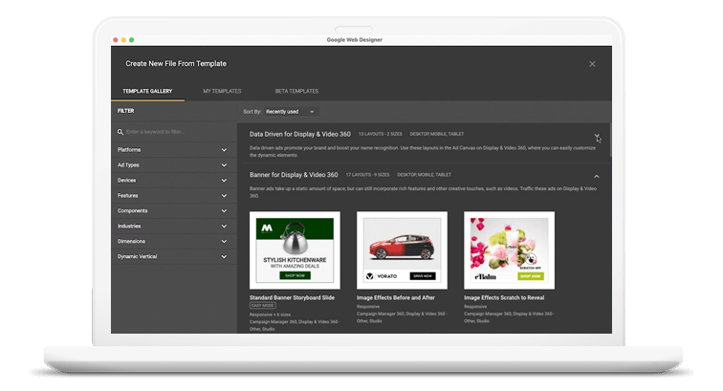
Quora Web Solution
Website Design and
Development
Company
Web Design & Web Development
Company in Bangalore, India
www.quorawebsolution.com
+91 9986 056 909
info@quorawebsolutions.com
24A, 1st Main Rd, Chandra Reddy
Layout, Koramangala 4th Block,
Koramangala, Bengaluru,
Karnataka 560034

Slide 2

The Role of Website Design and Development Companies in Enhancing User Experience
www.quorawebsolution.com

Slide 3

In today’s digital world, a website’s user experience (UX) is crucial to its success.
www.quorawebsolution.com

Slide 4

Website design and development companies are at the heart of creating seamless, engaging, and functional digital experiences for users.
www.quorawebsolution.com

Slide 5
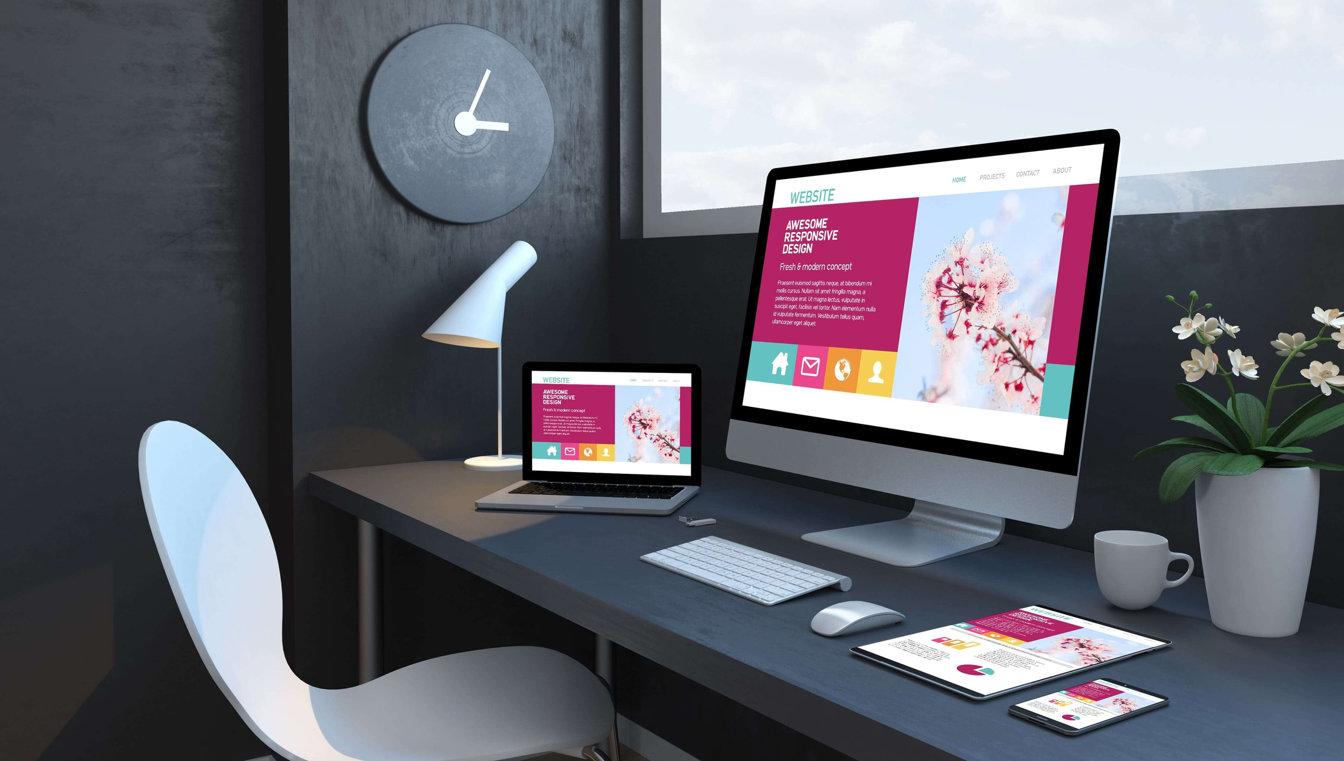
These companies use a variety of strategies to ensure that websites are not only visually appealing but also easy to navigate, mobile-friendly, fast, and secure.
www.quorawebsolution.com

Slide 6
Here’s how they contribute to enhancing UX.
1. User-Centered Design
Designing with the user in mind is essential. Website design and development companies prioritize user-centered design, creating websites that are intuitive and easy to use. By conducting user research and developing personas, they ensure that the website aligns with the needs and behaviors of its target audience.
2. Mobile-First and Responsive Design
As mobile usage continues to grow, it’s vital for websites to be responsive and mobile-friendly. Design and development companies adopt a mobile-first approach, ensuring the site works well on any device, from smartphones to desktops. This approach provides a smooth experience for users, regardless of the device they use.
www.quorawebsolution.com

Slide 7
3. Speed Optimization
Website speed plays a significant role in user experience. Slow loading times can lead to high bounce rates. Design and development companies optimize website performance by compressing images, reducing unnecessary code, and ensuring fast server responses, ensuring a quick and smooth browsing experience.
4. Clear Navigation
A website’s navigation should be simple and intuitive. Design and development companies focus on creating clear, easy-to-use menus, search functions, and call-to-action buttons, allowing users to find what they need quickly and efficiently.
5. Visual Appeal
A well-designed website is visually engaging and aligns with a brand’s identity. Aesthetically pleasing websites are more likely to retain users and encourage them to explore further. Companies use color schemes, fonts, images, and layouts to create an appealing, cohesive design that enhances user engagement.
www.quorawebsolution.com

Slide 8
6. Security and Trust
Web security is a key aspect of user experience. A secure website gives users peace of mind, especially when sharing personal information. Design and development companies integrate SSL certificates, secure payment systems, and privacy policies to build trust with users.
Conclusion
Website design and development companies are essential in creating websites that deliver a positive user experience. By focusing on user-centered design, mobile optimization, site speed, intuitive navigation, and security, these companies help businesses create websites that not only attract visitors but also engage them, build trust, and drive conversions. A well-designed website is key to business success in the digital era.
10 Key Services Every Leading Website Design and Development Company Should Offer
www.quorawebsolution.com

Slide 9
A top-tier website design and development company must provide a comprehensive suite of services to create high-performing, visually appealing, and user-friendly websites. Here are 10 essential services that such companies should offer:
Custom Website Design Custom design is crucial to make a website stand out. A leading agency should offer personalized, creative solutions tailored to the client’s brand, ensuring the website is not only functional but also unique.
Responsive Web Design With the growing use of mobile devices, responsive design is a must. The website should automatically adapt to various screen sizes for a seamless user experience on phones, tablets, and desktops.
E-commerce Development For businesses looking to sell online, e-commerce development is critical. A proficient company should offer secure, easy-to-navigate, and scalable e-commerce solutions.
www.quorawebsolution.com

Slide 10
Content Management Systems (CMS) Integration CMS platforms like WordPress, Joomla, or Drupal allow businesses to manage their website content easily. A good web development company should be adept at integrating and customizing these systems.
Search Engine Optimization (SEO) SEO optimization is key for driving traffic to a website. Leading companies should ensure that the website is built with on-page SEO best practices, like keyword research, meta tags, and optimized code.
Web Application Development For businesses needing more than just a static website, web application development services enable complex functions like user login, databases, and advanced interaction.
Website Maintenance and Support Websites need regular updates and maintenance.
www.quorawebsolution.com

Slide 11
The best companies provide ongoing support, handling bug fixes, updates, and performance enhancements.
Branding and Graphic Design A professional company will assist with creating a cohesive brand identity through custom logos, color schemes, typography, and overall design, ensuring the website aligns with the client’s branding strategy.
Website Speed Optimization Slow-loading websites hurt user experience and SEO rankings. Leading agencies should optimize website performance by compressing images, improving server speed, and refining code to ensure faster load times.
Security Features Website security is a top priority to protect against data breaches and cyberattacks.
www.quorawebsolution.com

Slide 12
A reputable company should implement SSL certificates, secure hosting, and regular security audits to keep websites safe.
By offering these essential services, a website design and development company can ensure its clients receive a professional, high-quality, and secure online presence that enhances their business.
www.quorawebsolution.com

Slide 13
Quora Web Solution: Quora Web Solution is a trusted website development company based in Bangalore, India, offering a wide array of services to not only domestic but global clientele. Be it Website Design and Development, SEO services, Digital Marketing, Branding, App Development, Ecommerce Solution, and Logo Creation . Quora Web Solution has the best website developers offering top quality services and that is the reason why we are well known as one of the best Website Development Companies in Bangalore, India.
Visit Us - www.quorawebsolution.com
Call Us - +91 9986 056 909
Mail Us - info@quorawebsolutions.com
www.quorawebsolution.com

Slide 14

WORDPRESS DEVELOPMENT
ECOMMERCE DEVELOPMENT
PHP DEVELOPMENT
CMS DEVELOPMENT
DRUPAL DEVELOPMENT
WEBSITE SERVICES
WEBPORTAL DEVELOPMENT
MAGENTO DEVELOPMENT
WEBSITE DEVELOPMENT
JOOMLA DEVELOPMENT
SMALL BUSINESS DEVELOPMENT
CHEAP WEBSITE DEVELOPMENT
STATIC WEBSITE DEVELOPMENT
DYNAMIC WEBSITE DEVELOPMENT
WEBSITE DESIGN COMPANY
TOUR AND TRAVEL WEBSITE DEVELOPMENT
Services

